Slide 1
2024 Mandatory – LREC Mandated Forms and Hot Topics
(VENDOR NAME)
(VENDOR#)

Slide 2
Module 1
UPDATES TO THE PROPERTY DISCLOSURE DOCUMENT

Slide 3
BASIC REVIEW OF PROPERTY DISCLOSURE
LAW THAT REQUIRES DISCLOSURE
WHO IS REQUIRED TO DISCLOSE

Slide 4
Part 1 –INTRODUCTION

Slide 8
BEST PRACTICES
ACTUAL KNOWLEDGE
OR
CONSTRUCTIVE KNOWLEDGE
Notes:
Actual knowledge means just that; the agent actually knew of an issue with the property and allowed the PDD to be sent to the Buyer anyway knowing that the PDD was inaccurate. Basically, unless the agents are actually aware that the information in the Property Disclosure Document is incorrect, there will be no liability.

Slide 9
KEY DEFINITIONS

Slide 11
Key Definitions
Residential Real Property
Known defect
EXPLAIN REAL ESTATE TERMS!

Slide 12
CASE STUDY REVIEW
FOUNDATION REPAIRS
Notes:
Orr v. Jones, a Jefferson Parish case which dealt with an older version of the PDD that did not specifically ask for information from Sellers about “foundation repairs,” still provides insight into “repairs” and the PDD. In that case, Sellers were sued for bad faith redhibition and agents for misrepresentation, for allegedly failing to disclose a defect with a foundation. The Court found the Sellers and Agent not liable because the evidence at trial shows that they believed the foundation to be repaired at the time of the disclosure to the Buyer and had no intent to mislead or defraud the Buyer. It is important to note that the true belief was the basis of the finding of no liability. Information that could have called that into question, such as an inspection report from a previous buyer who did not close on the property which called into question whether the foundation was truly repaired, could change a Court’s decision.

Slide 13
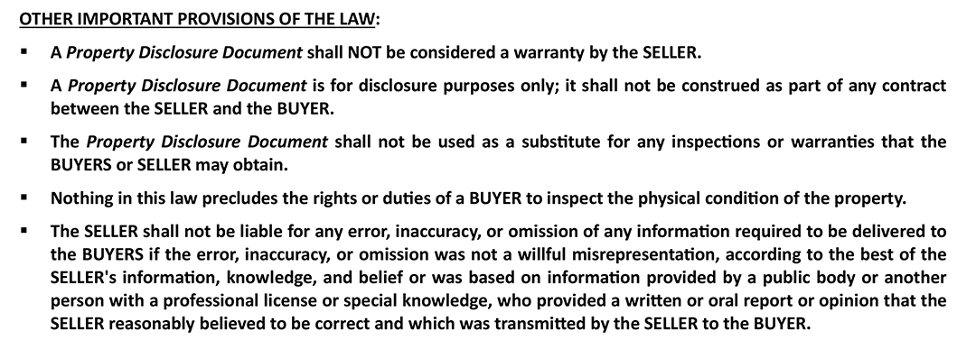

Slide 14
EXEMPTION FORM

Slide 17
BEST PRACTICES
CHECK ALL THAT APPLY
LEFT UNCHECKED HERE COULD CAUSE CONFUSION

Slide 18
SELLER ACKNOWLEDGEMENTS

Slide 19
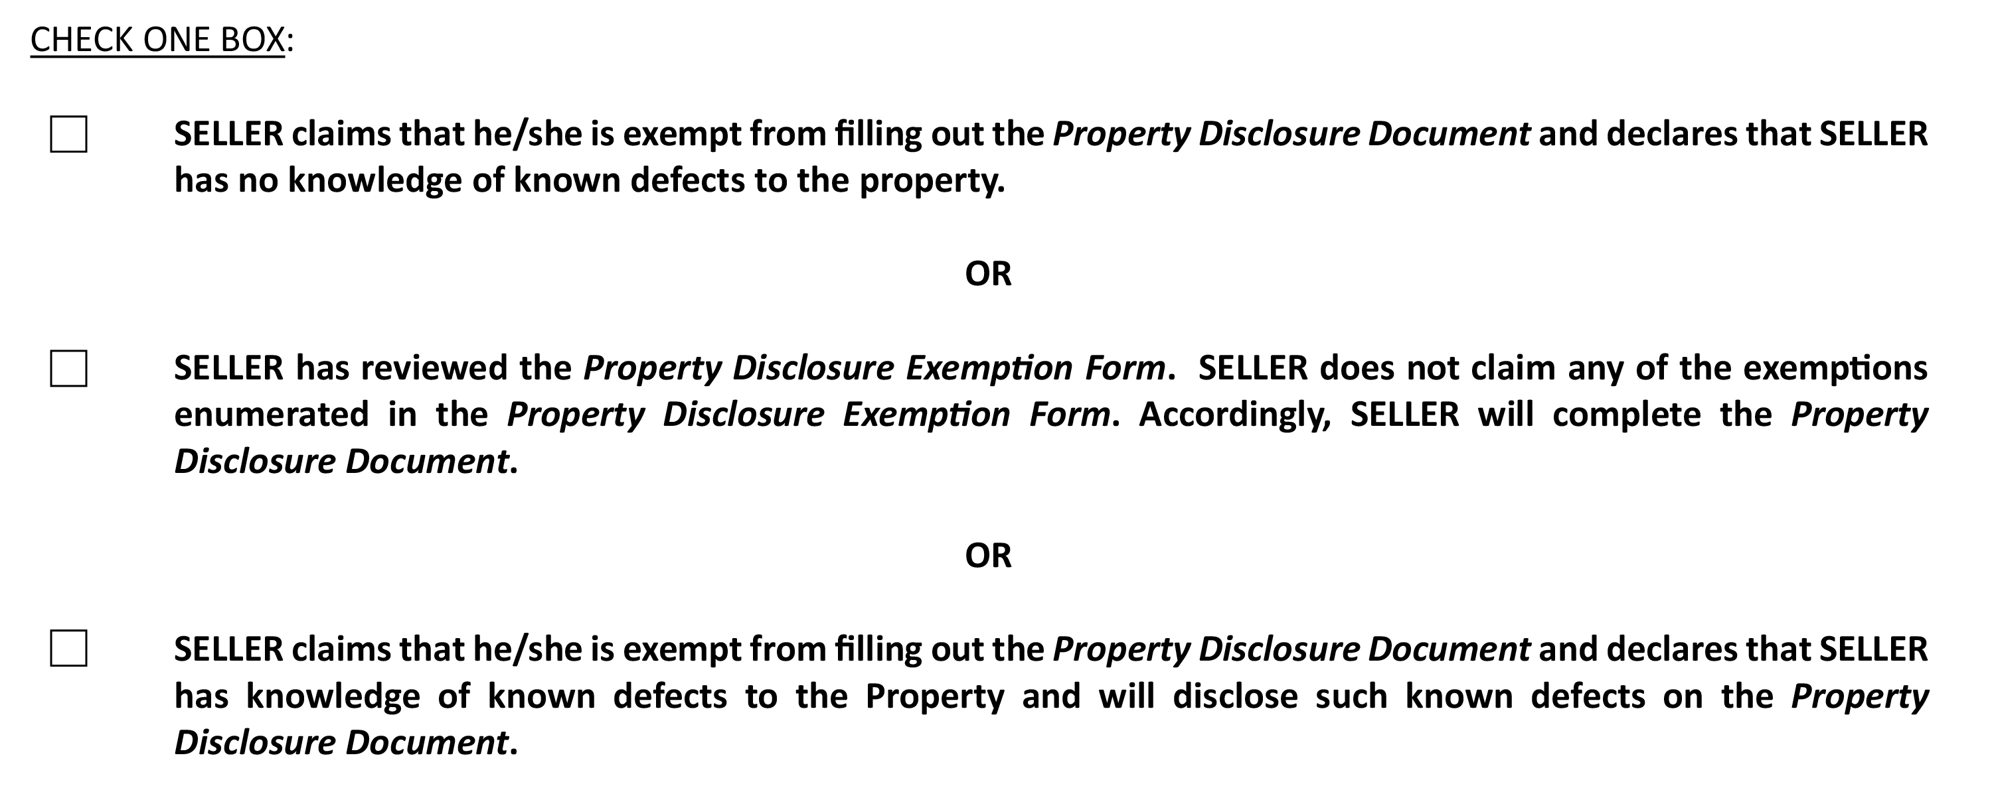

Slide 20
BEST PRACTICES
WHY A THIRD OPTION WAS ADDED HERE
REMEMBER SELLER’S REQUIREMENTS ESPECIALLY KNOWN DEFECTS EVEN IF EXEMPT
Notes:
This is a great addition by the LREC, and as discussed above, makes disclosure
obligations more clear. It helps to take the spotlight, or more appropriately the blame, off the agents
when a Seller attempts to state that “the Agent told me I was exempt from the disclosure form.”
Now, for example, a succession administrator, who is exempt, is having to either acknowledge
they have no knowledge of defects or will have to fill out a PDD even if exempt

Slide 21
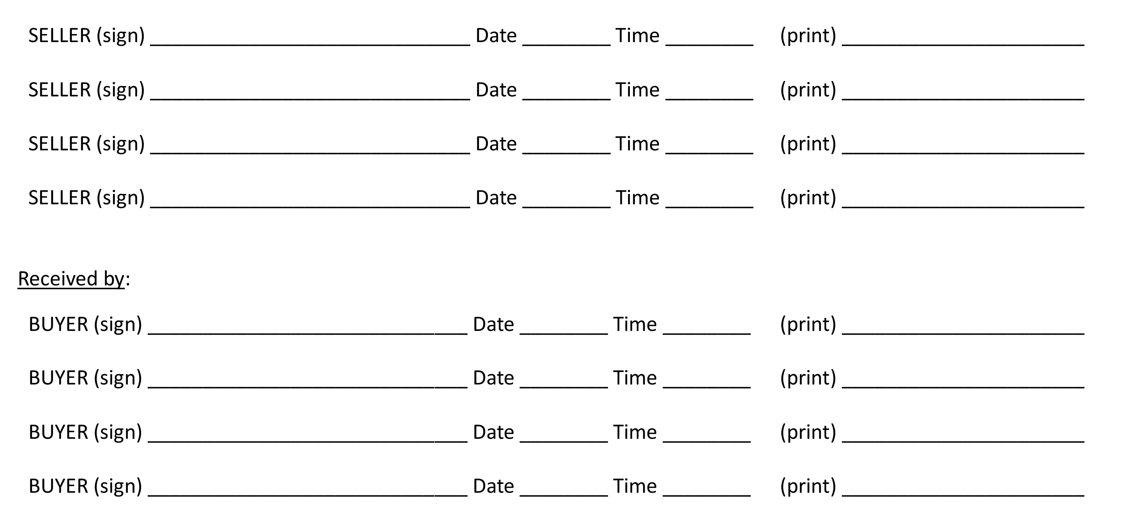

Slide 22
BEST PRACTICES
ENSURE PROPER SIGNATURES/DATE/TIME
MUST SIGN HERE AND END OF PDD FORM

Slide 24
BEST PRACTICES
DIFFERENCE IN “Y”, “N”, AND “NK”
RELATE BACK TO ACTUAL KNOWLEDGE
Notes:
In discussing the responses to the Property Disclosure Form questions, reading the
above box which explains that the disclosure is based upon “actual knowledge” is a great practice.
The actual knowledge standard is heightened, one must know about the issue – full stop.

Slide 25
PDD- SECTION 1

Slide 26
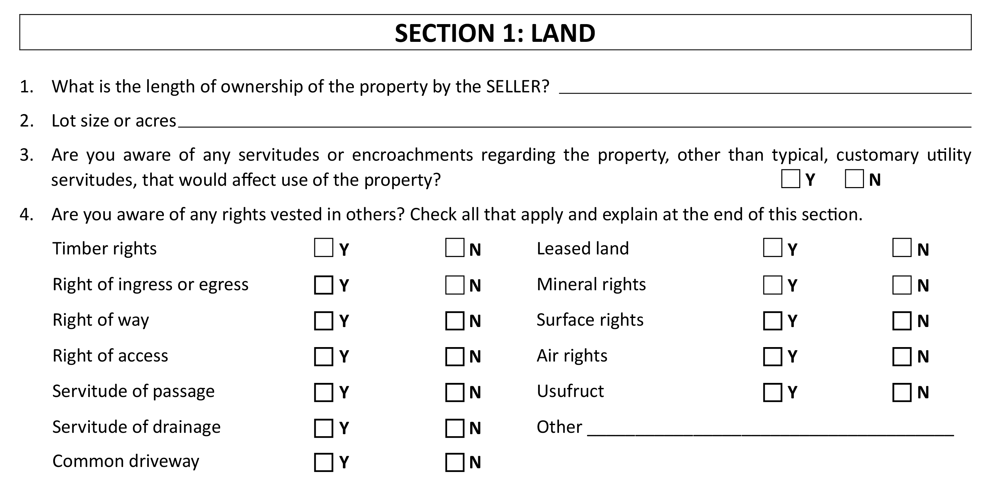
Notes:
Point out addition of leased land option.

Slide 27
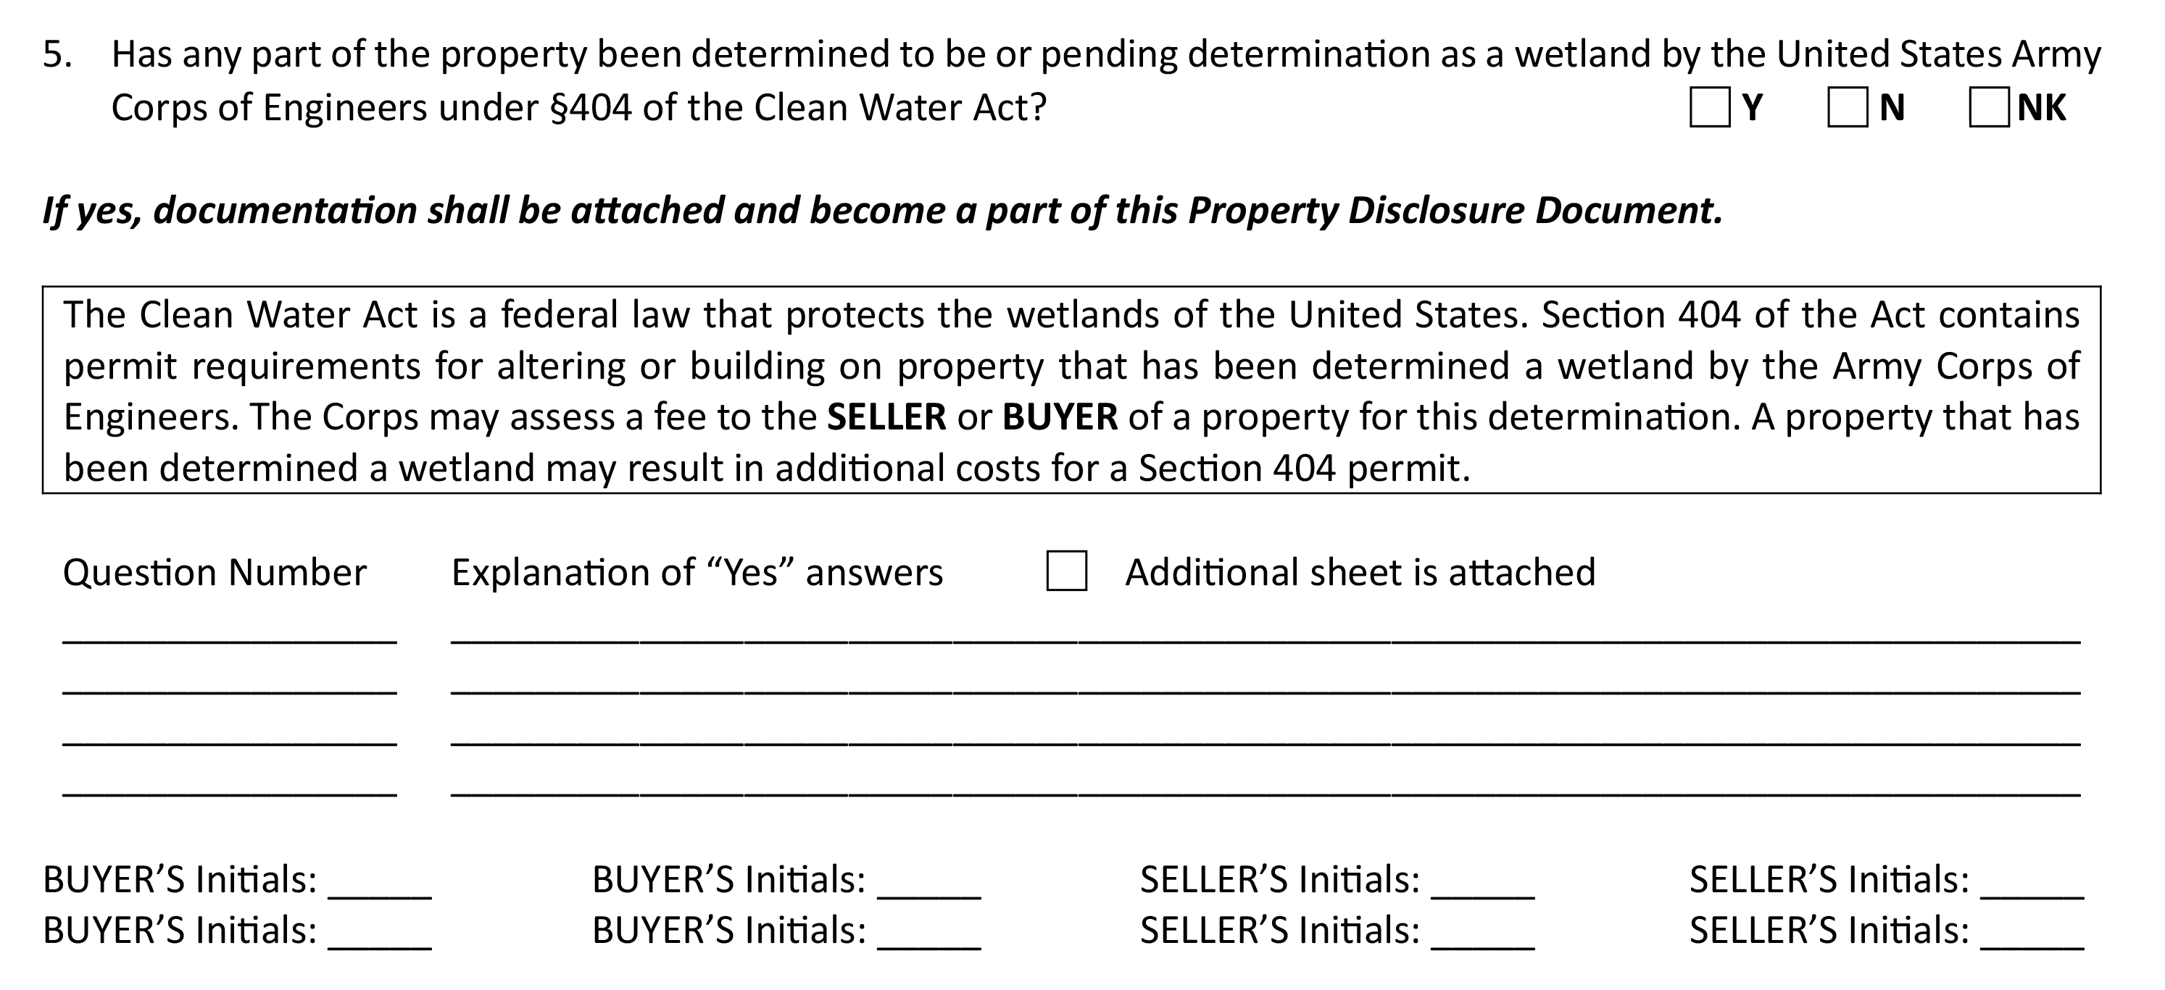
Notes:
Nothing has really changed in this section of the form. As a good reminder each
section includes an area such as you’ll notice here for additional information and explanation for
“Yes” answers.

Slide 28
BEST PRACTICES

Slide 29
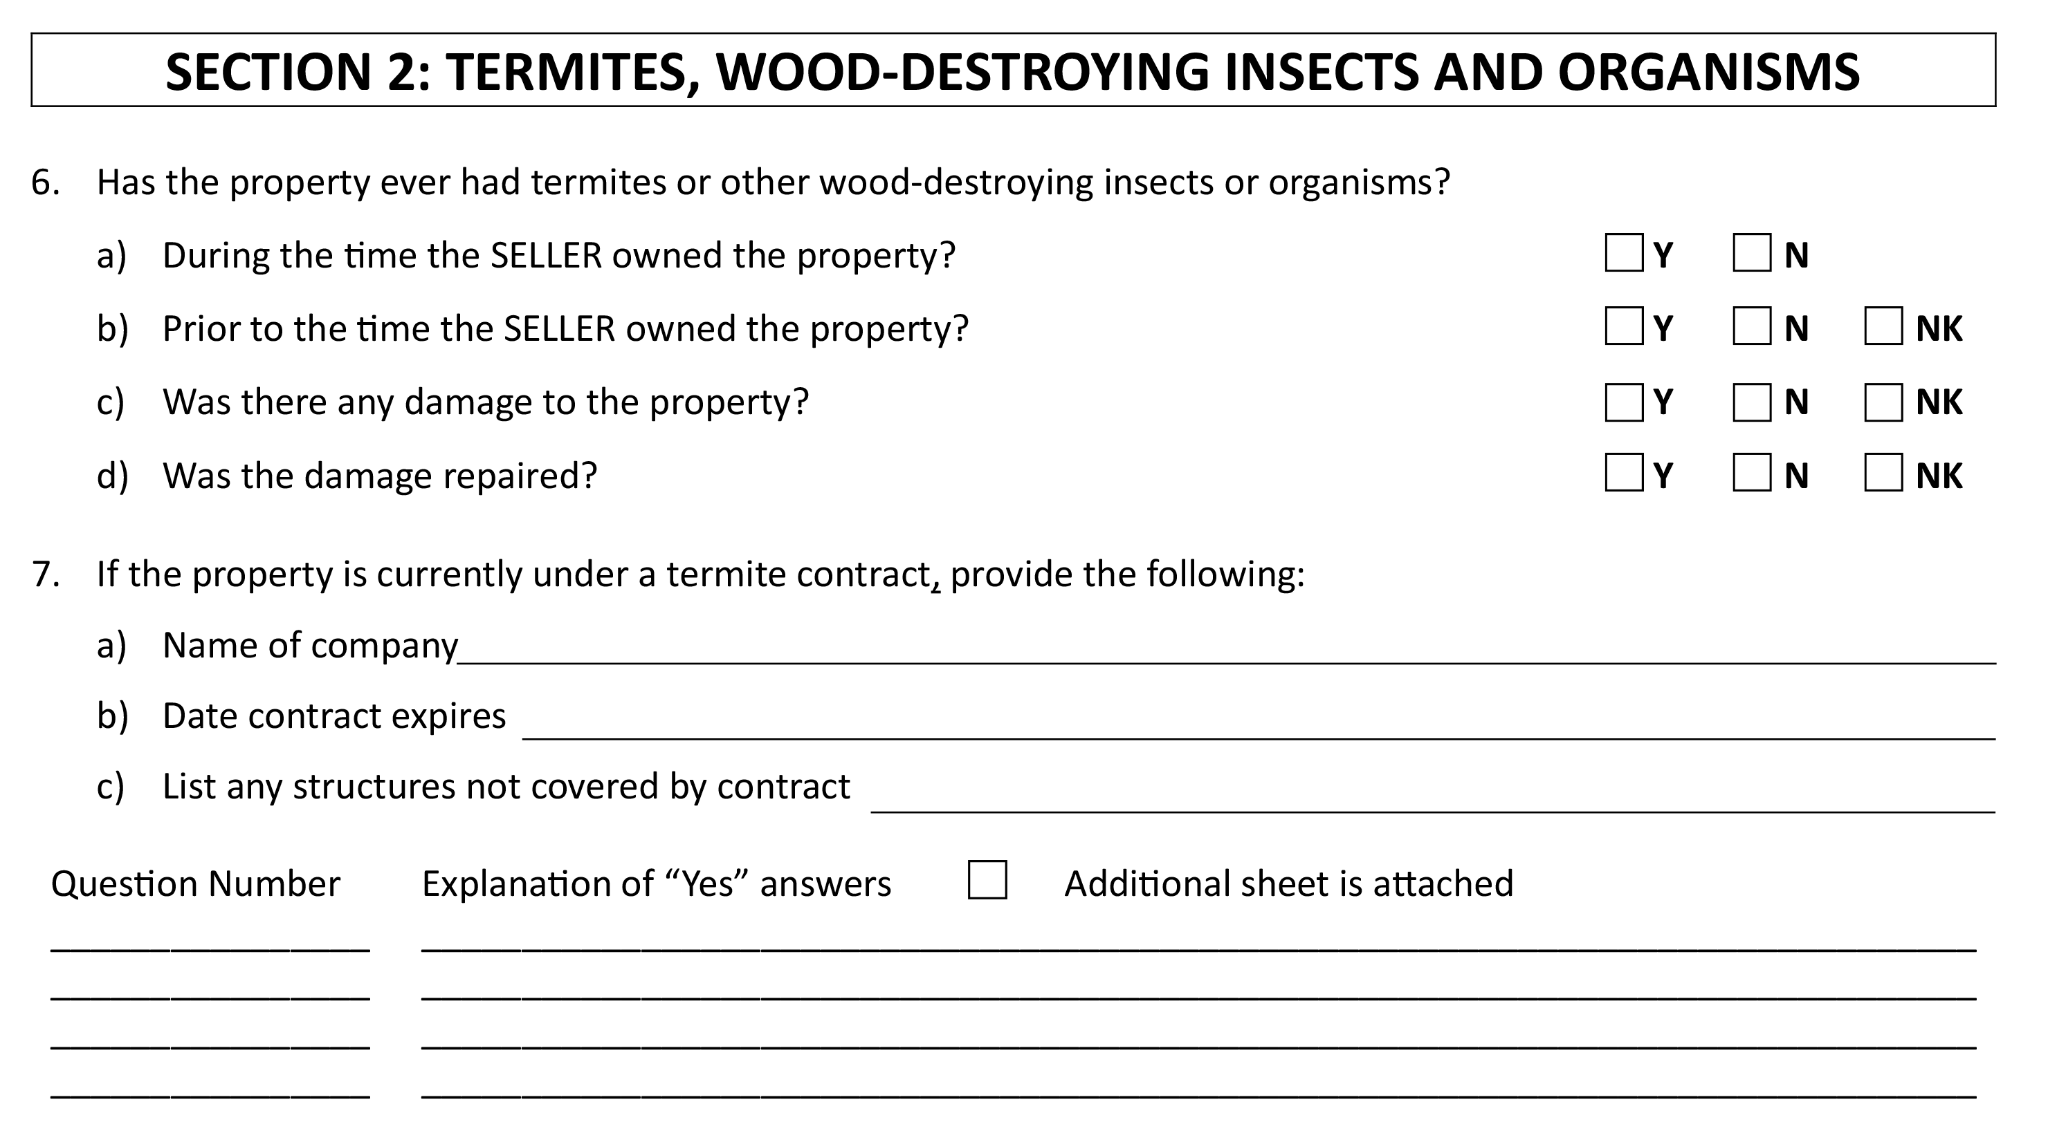
Notes:
In this section the only slight change was the addition of the “N” choice box for
items c and d under choice 6. Previously the only choice here was either “Y” or “NK”, and the
“N” box was added for clarity from the seller. For instance, if the seller’s knowledge is that there
was no damage to the property and/or nothing was repaired then a clear no is likely a better
choice than simply Not Known.

Slide 30
BEST PRACTICES
WRITING EXPLANATION OF “Y” ANSWERS
EACH SECTION HAS AN AREA FOR EXPLANATION
Notes:
The written “Explanation of Yes Answers” sections found throughout the Property
Disclosure Form is where a lot of Sellers, and sadly by association, their agents, get into trouble.
Numerous lawsuits have been filed arising out of situations such as “yes the seller stated there was
prior flooding, but only wrote about a hose leak in a laundry room and not the 5 feet of water from
Hurricane Ida.” That is obviously a glaring example, but arguments do get made that explanations
are not detailed enough, so it is best to tell your clients to be sure they are providing an explanation
to all issues when they mark “Yes” to a question that calls for more detail.

Slide 32
BEST PRACTICES
WHEN/WHY TO PROVIDE DOCUMENTATION
IMPORTANCE OF ADDING “N” AS A CHOICE
Notes:
Termite disclosures are the root of a lot of litigation in Louisiana. And the
failure to provide full documentation or explanation to the termite section is usually a
reason for it. “Repairs” were discussed earlier, but it must be restated – you need to have a
legitimate belief that the repairs fixed all of the issues in order to avoid liability such as past
termite issues. Almost every agent in Louisiana has dealt with a Seller who discloses that their
property had termites, but that it was repaired. There are also many agents who know of Sellers
who report that way, but were also in possession of information, such as a Wood Destroying
Insect Report (WIDR), that calls into question whether or not the repairs were complete and
Seller failed to disclose the same. Sellers need to explain this information clearly and fully.

Slide 33
PDD – SECTION 3

Slide 34
Notes:
Only slight change here to the wording on #8 to better match the area below
where the disclosure asks for details on the age of the main structure as well as other structures.
By using the language “each structure,” a seller should separate each structure and provide the
approximate age of each structure separately in the area provided.

Slide 35
PDD – SECTION 4

Slide 36
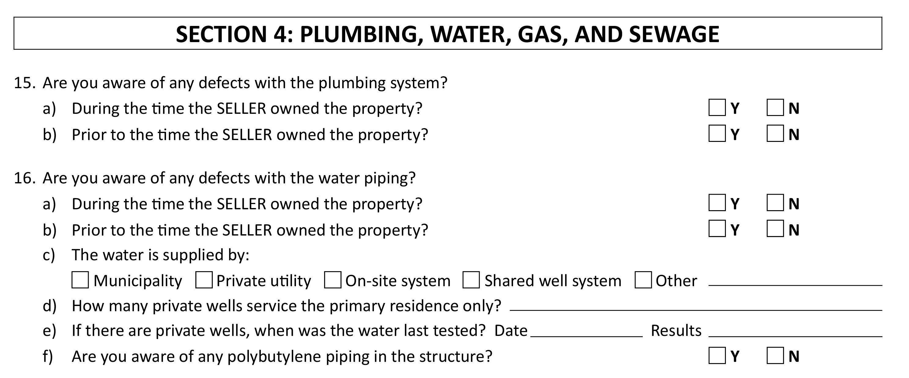
Notes:
In this section you’ll notice some changes in the way the disclosure questions are
worded and as a result changes to the selection choices. For instance, in several places the phrase
“are there any known” is replaced by the phrase “are you aware of any” defects. As a result, in
these same areas you’ll also see that the “NK” choice was removed.

Slide 37
Notes:
The difference in the amended language here better matches the law and the key definitions laid
out earlier in the PDD. The seller is being asked if “they are aware” - which eliminates the need
for a “NK” choice. Therefore, a seller should carefully consider each item asked about in this
section and choose the best selection based on the best of their knowledge. As a reminder, any
further details, or explanations can be provided in the blanks provided at the end of the section.

Slide 38
BEST PRACTICES
WATCH FOR “PRIOR TO OWNED” QUESTIONS!
Notes:
Beware the “prior to the time Seller owned the Property” questions. Issues have arisen where the Seller marked no, but the Plaintiff was able to go back to the transaction file of the Seller’s own purchase of the property and locate past property disclosure forms which stated there was an issue. The Seller may not even remember that, but that is powerful evidence against a Seller. It is good practice to remind Seller to think back at their past closing file when it comes to the “prior to the time Seller owned the Property” questions.

Slide 39
PDD - SECTION 5

Slide 40
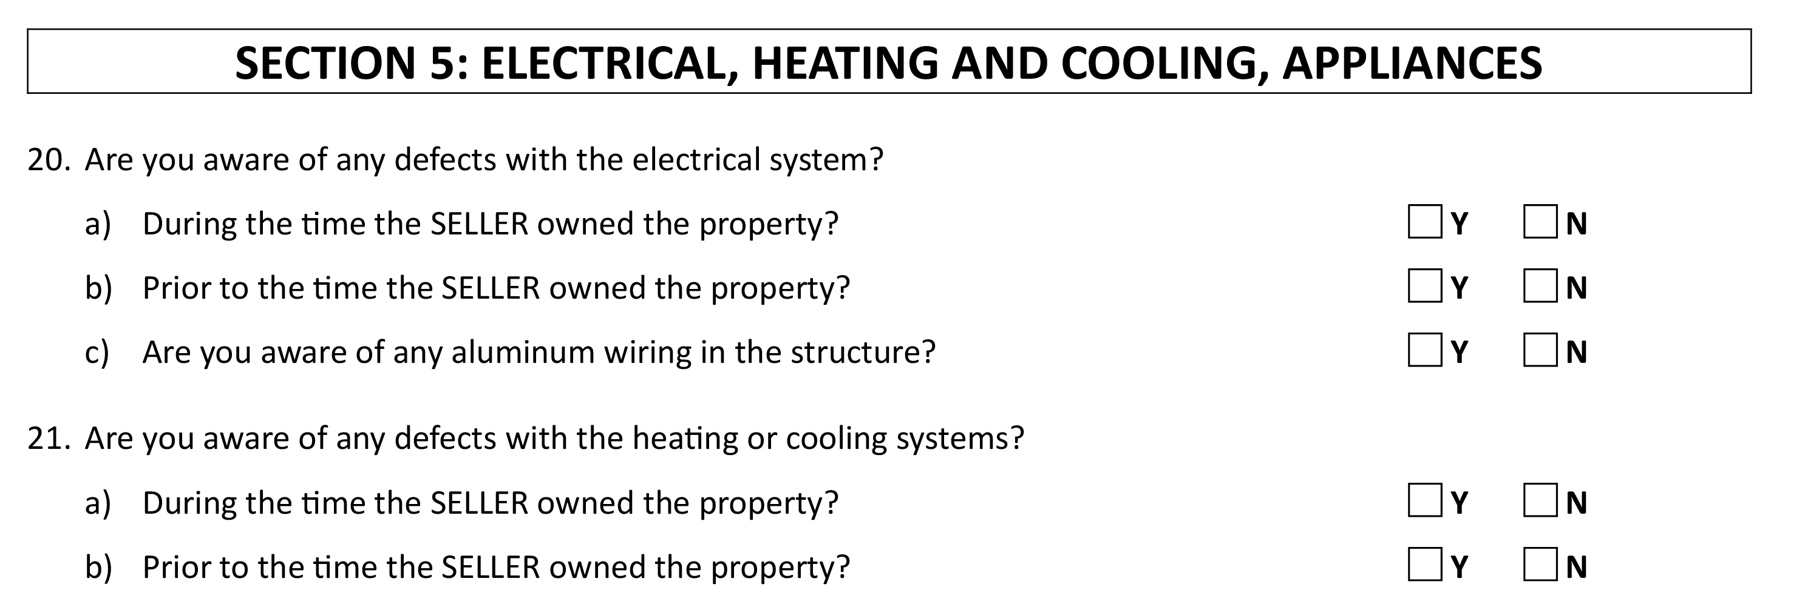
Notes:
Very similar to the previous section, you’ll notice the main questions asked for each item number now utilize the same phrase “are you aware” of any defects. Just as before the “NK” selection was also removed to better match the question as it is asked here. Another reminder as to the importance of those key terms and definitions previously outlined.

Slide 42
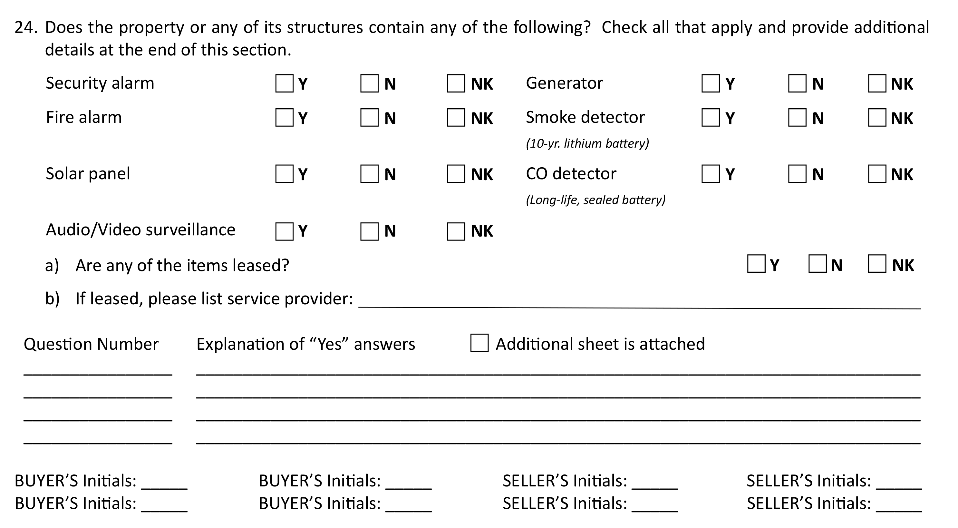
Notes:
: You’ll notice some changes here within Question 24 under Section 5. Previously this section only addressed installed security systems. Now you’ll see it has been expanded to cover various security-related items including solar panels, generators, smoke detectors, Carbon Monoxide (CO) detectors etc. Later in the document you’ll see that questions that used to address these such as solar panels (former question #53) have been removed.

Slide 43
BEST PRACTICES
SELLER SHOULD KNOW THESE ANSWERS
THERE IS A DIFFERENCE BETWEEN “N” AND “NK!”
Notes:
A Seller should know the answers to these questions, so there should rarely be mistakes on them. But be wary of questions with Generators, especially with whether it is a “whole home generator.” As silly as it sounds, people have different expectations as to what a “whole home generator” is; i.e. covers the major appliances or ia able to cover every plugged in iPhone, iPad, and every other appliance and light running simultaneously while four loads of laundry and dishes are running. As crazy as it sounds, multiple claims and lawsuits have been filed on this issue, which are a waste of time, but you would rather not deal with it. So be careful.

Slide 44
Notes:
Only one small update here to the FEMA-related websites where flood map and risk zone information can be found

Slide 45
BEST PRACTICES
THIS INFORMATION IS AS IMPORTANT AS EVER!
LICENSEES SHOULD MAKE EFFORTS TO GATHER SUPPORTING DOCUMENTATION
Notes:
At this point in Louisiana, Courts (and most Louisiana residents) are not sympathetic to a Seller who does not know its flood zone classification or misstated it. Make sure the Seller is aware of their designation.

Slide 46
Notes:
The last sentence in bold print has been added in this section. The addition reiterates the importance of the seller’s requirement to disclose any and all known defects. Therefore, if something has materially changed the parties to the document should be notified in writing

Slide 47
BEST PRACTICES
WHEN AND WHY TO UPDATE THE PDD!
Notes:
The last sentence - This is a great inclusion which will help to clear up years of arguments by Plaintiffs’ attorneys that even though they were informed via email or text of an issue/defect that popped up, since the Property Disclosure Form was not amended, there is still potential liability. Make sure your client tells the other side of any change in writing; it protects them and likely you.

Slide 48
Module 2
UPDATES TO THE RESIDENTIAL AGREEMENT TO BUY OR SELL

Slide 49
GENERAL NOTES AND CHANGES
MANDATED 1/1/2024
MINOR REVISIONS
WATCH FOR CHANGE IN LINE NUMBERS!
Notes:
The font throughout the document was enlarged to make the form easier to read in all formats including electronic delivery.
Many small revisions were made to formatting as you would expect anytime the contract is revised and this course will not focus on non-material revisions such as these.
A full, red-lined copy of the contract is included in the Appendix if you wish to see every revision from the current to the updated version of the contract.
As with any contract update, please note some line numbers have changed and you may want to revise and/or update any related documents or software accordingly.
The most current version of the Residential Agreement to Buy or Sell must always be used to follow the requirements set forth in the Law and Rules.
The updated version discussed here becomes effective January 1, 2024.

Slide 50
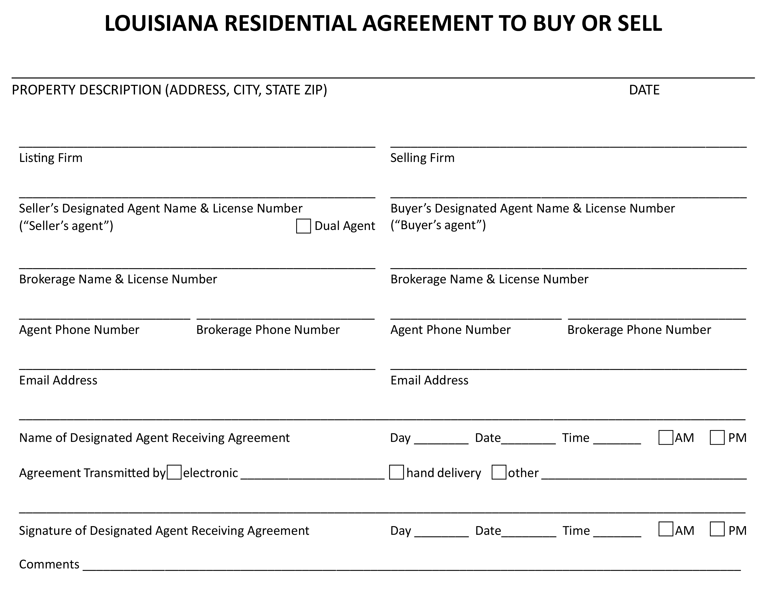
Notes:
You will notice that the first page of the agreement has largely been left unchanged. There’s been a small revision to location of the dual agency checkbox on the page.

Slide 51
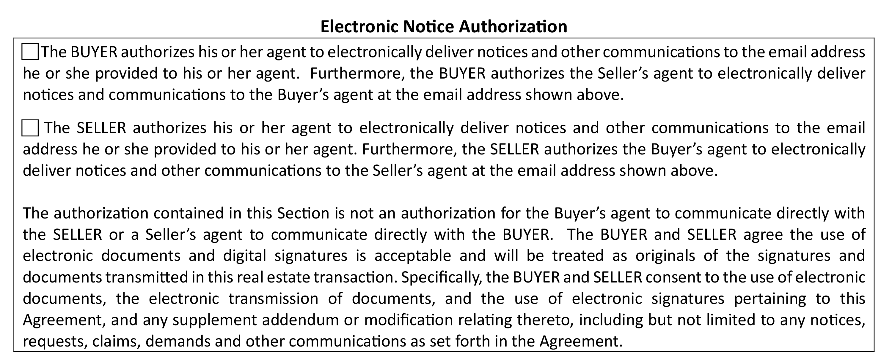

Slide 52
BEST PRACTICES
PROPER DISCLOSED DUAL AGENCY
WHY ELECTRONIC NOTIFICATION MUST BE AUTHORIZED
Notes:
In today’s world, the agreement of the Buyer and Seller to allow for the use of electronic notice and other communications should be normal procedure. It allows for easy access and communication and allows for changes to take place quickly when needed. It is a good idea to explain to your clients the benefits of allowing for Electronic Notice in residential real estate transactions.

Slide 53
PROPERTY DESCRIPTION

Slide 54
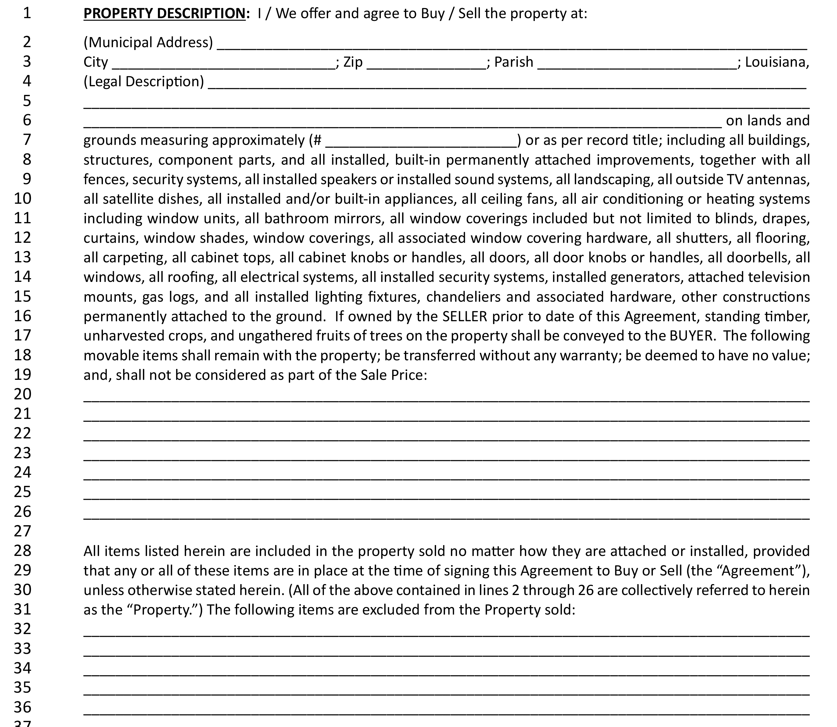
Notes:
You’ll notice some language change on lines 18-20 in the section regarding movable items (personal property) remaining with the property. First the legal term “shall” is added to better match the law and improve continuity throughout the form.

Slide 55
BEST PRACTICES
“NO VALUE” YET VALUABLE IN WRITING
ENTIRE AGREEMENT - IF INTENDED INCLUDE ON THIS FORM!
Notes:
This cleaned up the language and made the sentence clearer. The “no value” position is generally the best way to handle movables that are transferred along with the property. Pool tables, chandeliers, specialty appliances are common examples. But do not be surprised in very high-priced real estate if there is pushback on the “no value” designation for movables that in actuality have a very high value. Lenders can have problems with financing a multimillion-dollar home when the value of the property is based upon and includes movables which can be left with the property

Slide 56
MINERAL RIGHTS

Slide 57
Notes:
One main theme in revisions to the forms was to streamline the documents wherever possible. One such example you will see here as the box surrounding the mineral rights section was removed. In addition to the box, you’ll also notice the signature lines for Buyer and Seller were also removed from this section

Slide 58
PRORATIONS, SPECIAL ASSESSMENTS, & OTHER COSTS

Slide 59
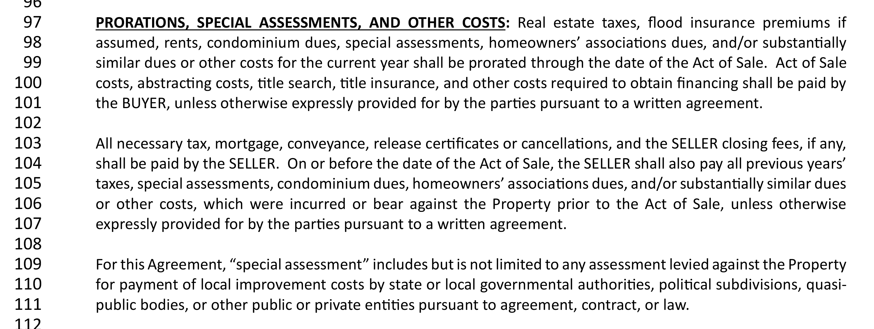
Notes:
You’ll notice quite a bit of language change and additional language in this section. As with many areas of the contract, as time goes on situations arise in the marketplace that may require additions and updates. This area is an example as you’ll notice the specific addition of “special assessments” added as well as language to clarify what is included and who is responsible for such costs. Added in Lines 113-115 is the following:
“special assessment” includes but is not limited to any assessment levied against the Property for payment of local improvement costs by state or local governmental authorities, political subdivisions, quasi- public bodies, or other public or private entities pursuant to agreement, contract, or law.

Slide 60
BEST PRACTICES
LICENSEES SHOULD KNOW WHICH PARTY IS RESPONSIBLE BY DEFAULT
REVIEW DEFINITION OF SPECIAL ASSESSMENT
REFER TO PDD FOR SELLER’S DISCLOSURE
Notes:
Given the skyrocketing costs in HOA and Condominium fees due to insurance costs and inflation, expect to see more negotiation and offers/discussion concerning who pays these fees. There are many examples of properties under a Property Association or a Condominium Association where special assessments have been significant and could be a burden on the Buyer if it was not disclosed. The failure to disclose these, especially when significant, has long been a topic of litigation against Seller sand their agents.

Slide 61
DEPOSIT HELD BY THIRD PARTY

Slide 62
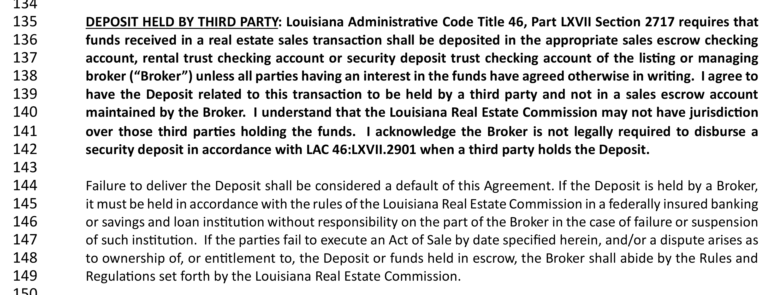
Notes:
In the spirit of streamlining, you’ll also notice revisions to the third-party deposit section. Like what you saw previously regarding mineral rights, in this section both the box and the signature areas were also removed here

Slide 63
LEASES & NEW HOME CONSTRUCTION

Slide 64
Notes:
You’ll notice the difference in this clause where references to special assessments and related items have been removed. Those items are covered in the previous section

Slide 65
NEW HOME CONSTRUCTION
Notes:
Wait a minute, there’s no picture here! Correct. This entire section has been repealed from the contract.

Slide 66
DUE DELIGENCE AND INSPECTION (DDI)

Slide 68
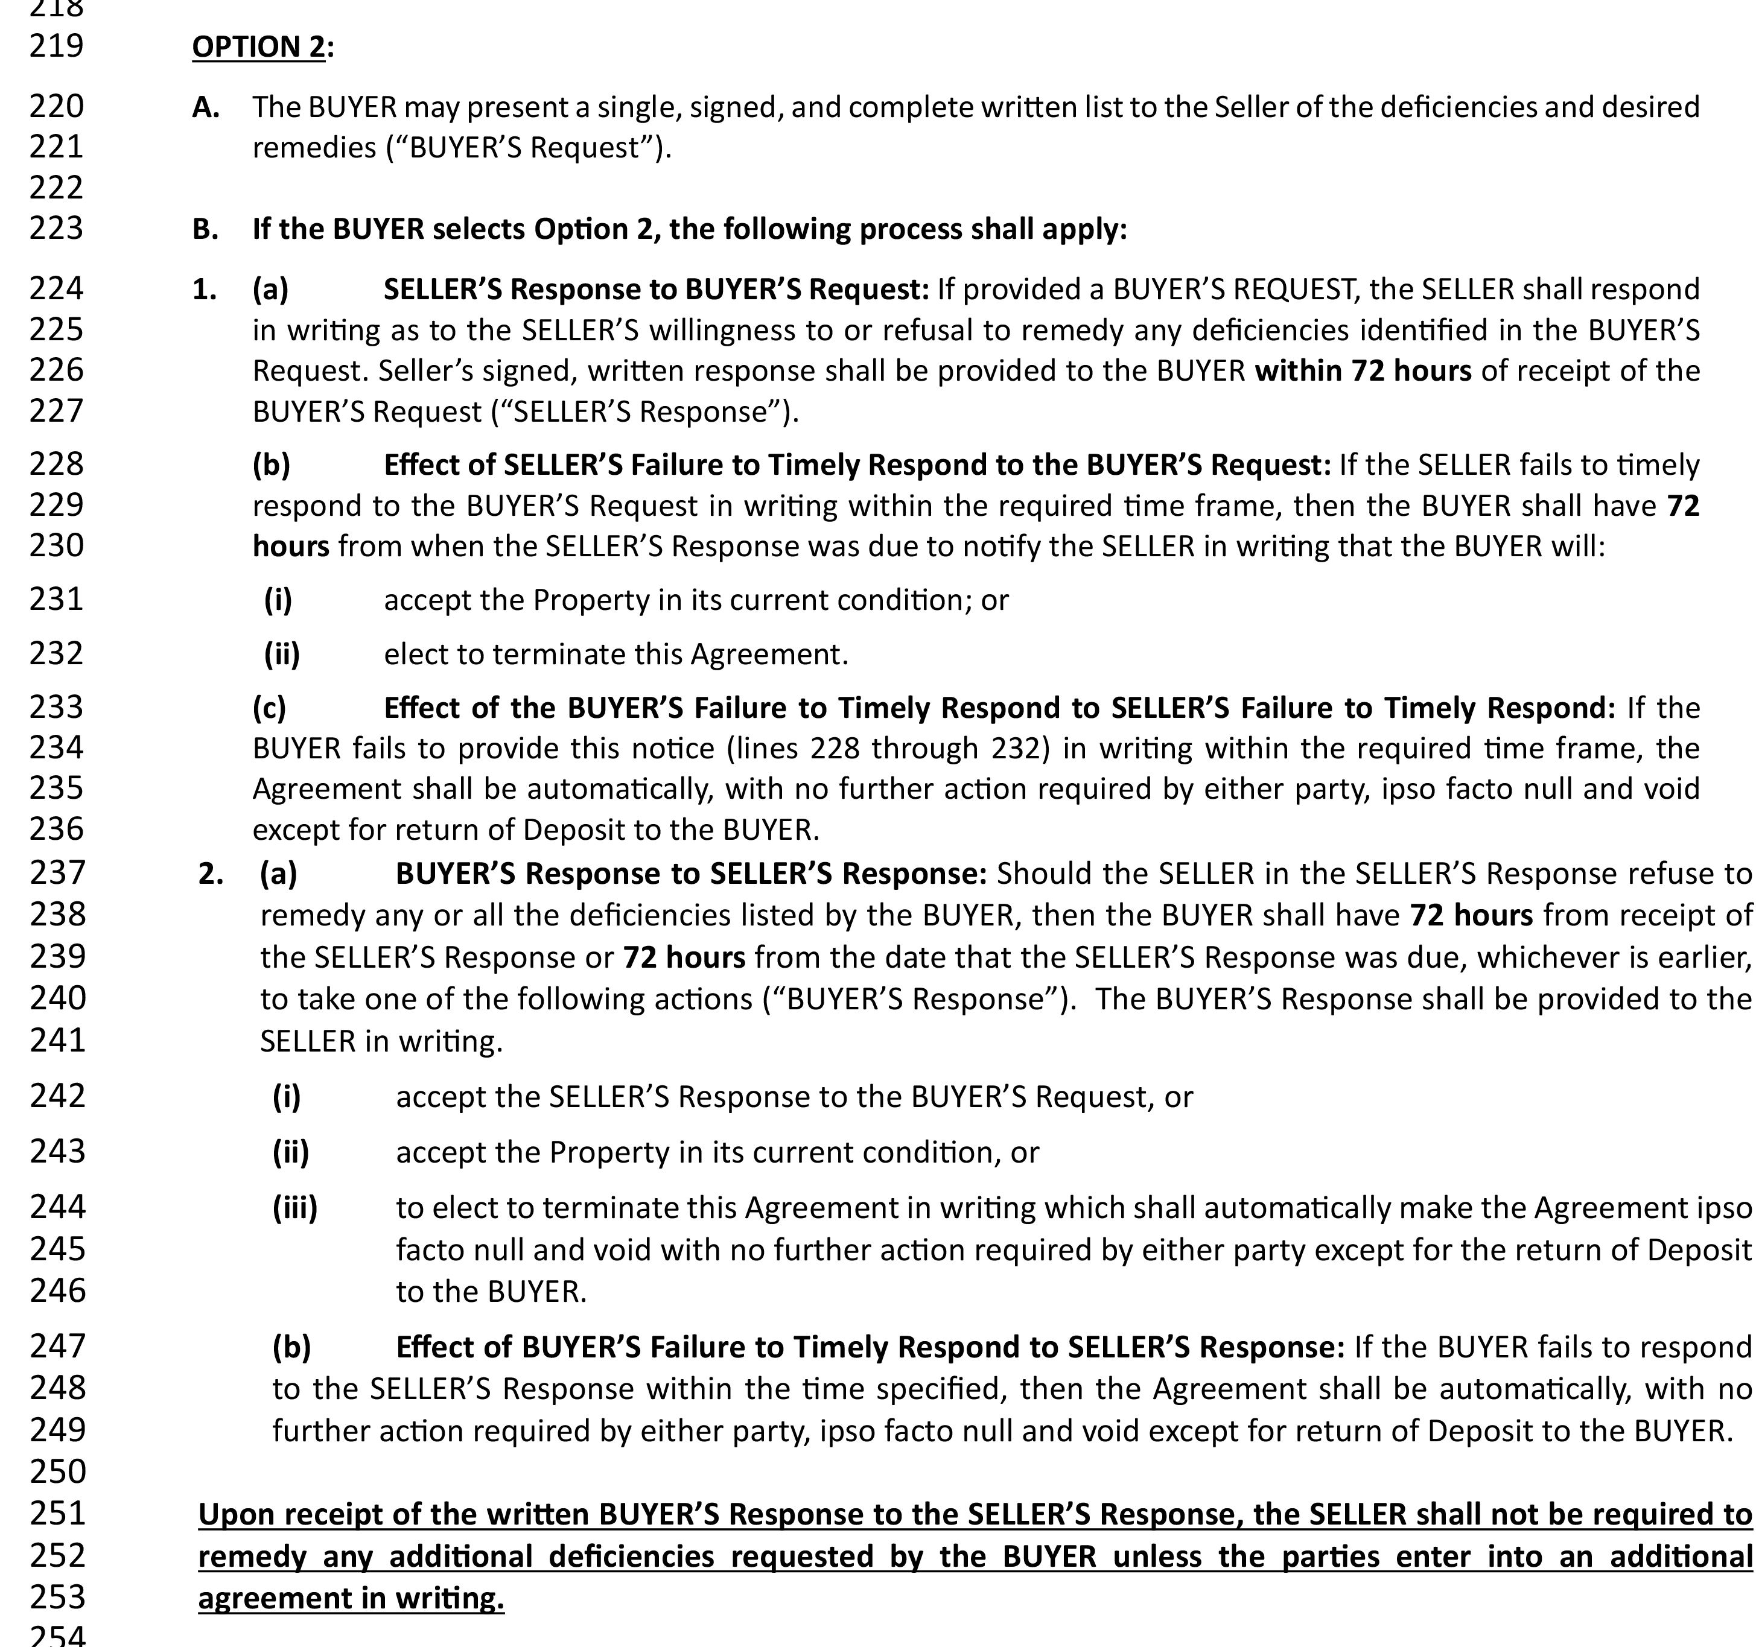
Notes:
After the significant revisions made to this section in 2022, not much needed to be changed here. The term “surveys” was added to line 207 as one of the stated examples of DDI period activities. The other change you’ll notice in this section is that “signed” was added to where the Buyer submits a complete written list and also within the Seller’s response option.

Slide 69
BEST PRACTICES
SMALL ADDITION BUT MIGHTY CHANGE
IMPORTANCE OF “SIGNED”
Notes:
It is important to note that the written list of deficiencies must be signed. Many agents force this as standard protocol already, but it is important to note the requirement now. The same applies to the Seller response under Option 2. The addition of the term “signed” reiterates the importance of both parties to the contract to submit written and signed items related to the DDI period clause.

Slide 70
ADDENDA TO BE ATTACHED

Slide 71
Notes:
: Not much to note here other than the removal of the “FHA Amendatory Clause.” You will also notice the “New Construction Addendum” is still an option as discussed previously as well as others you may add that are not pre-printed here

Slide 72
Notes:
There it is again! The term “shall” was also placed here on line 403 to properly outline the legal obligation of the parties to accept in writing

Slide 73
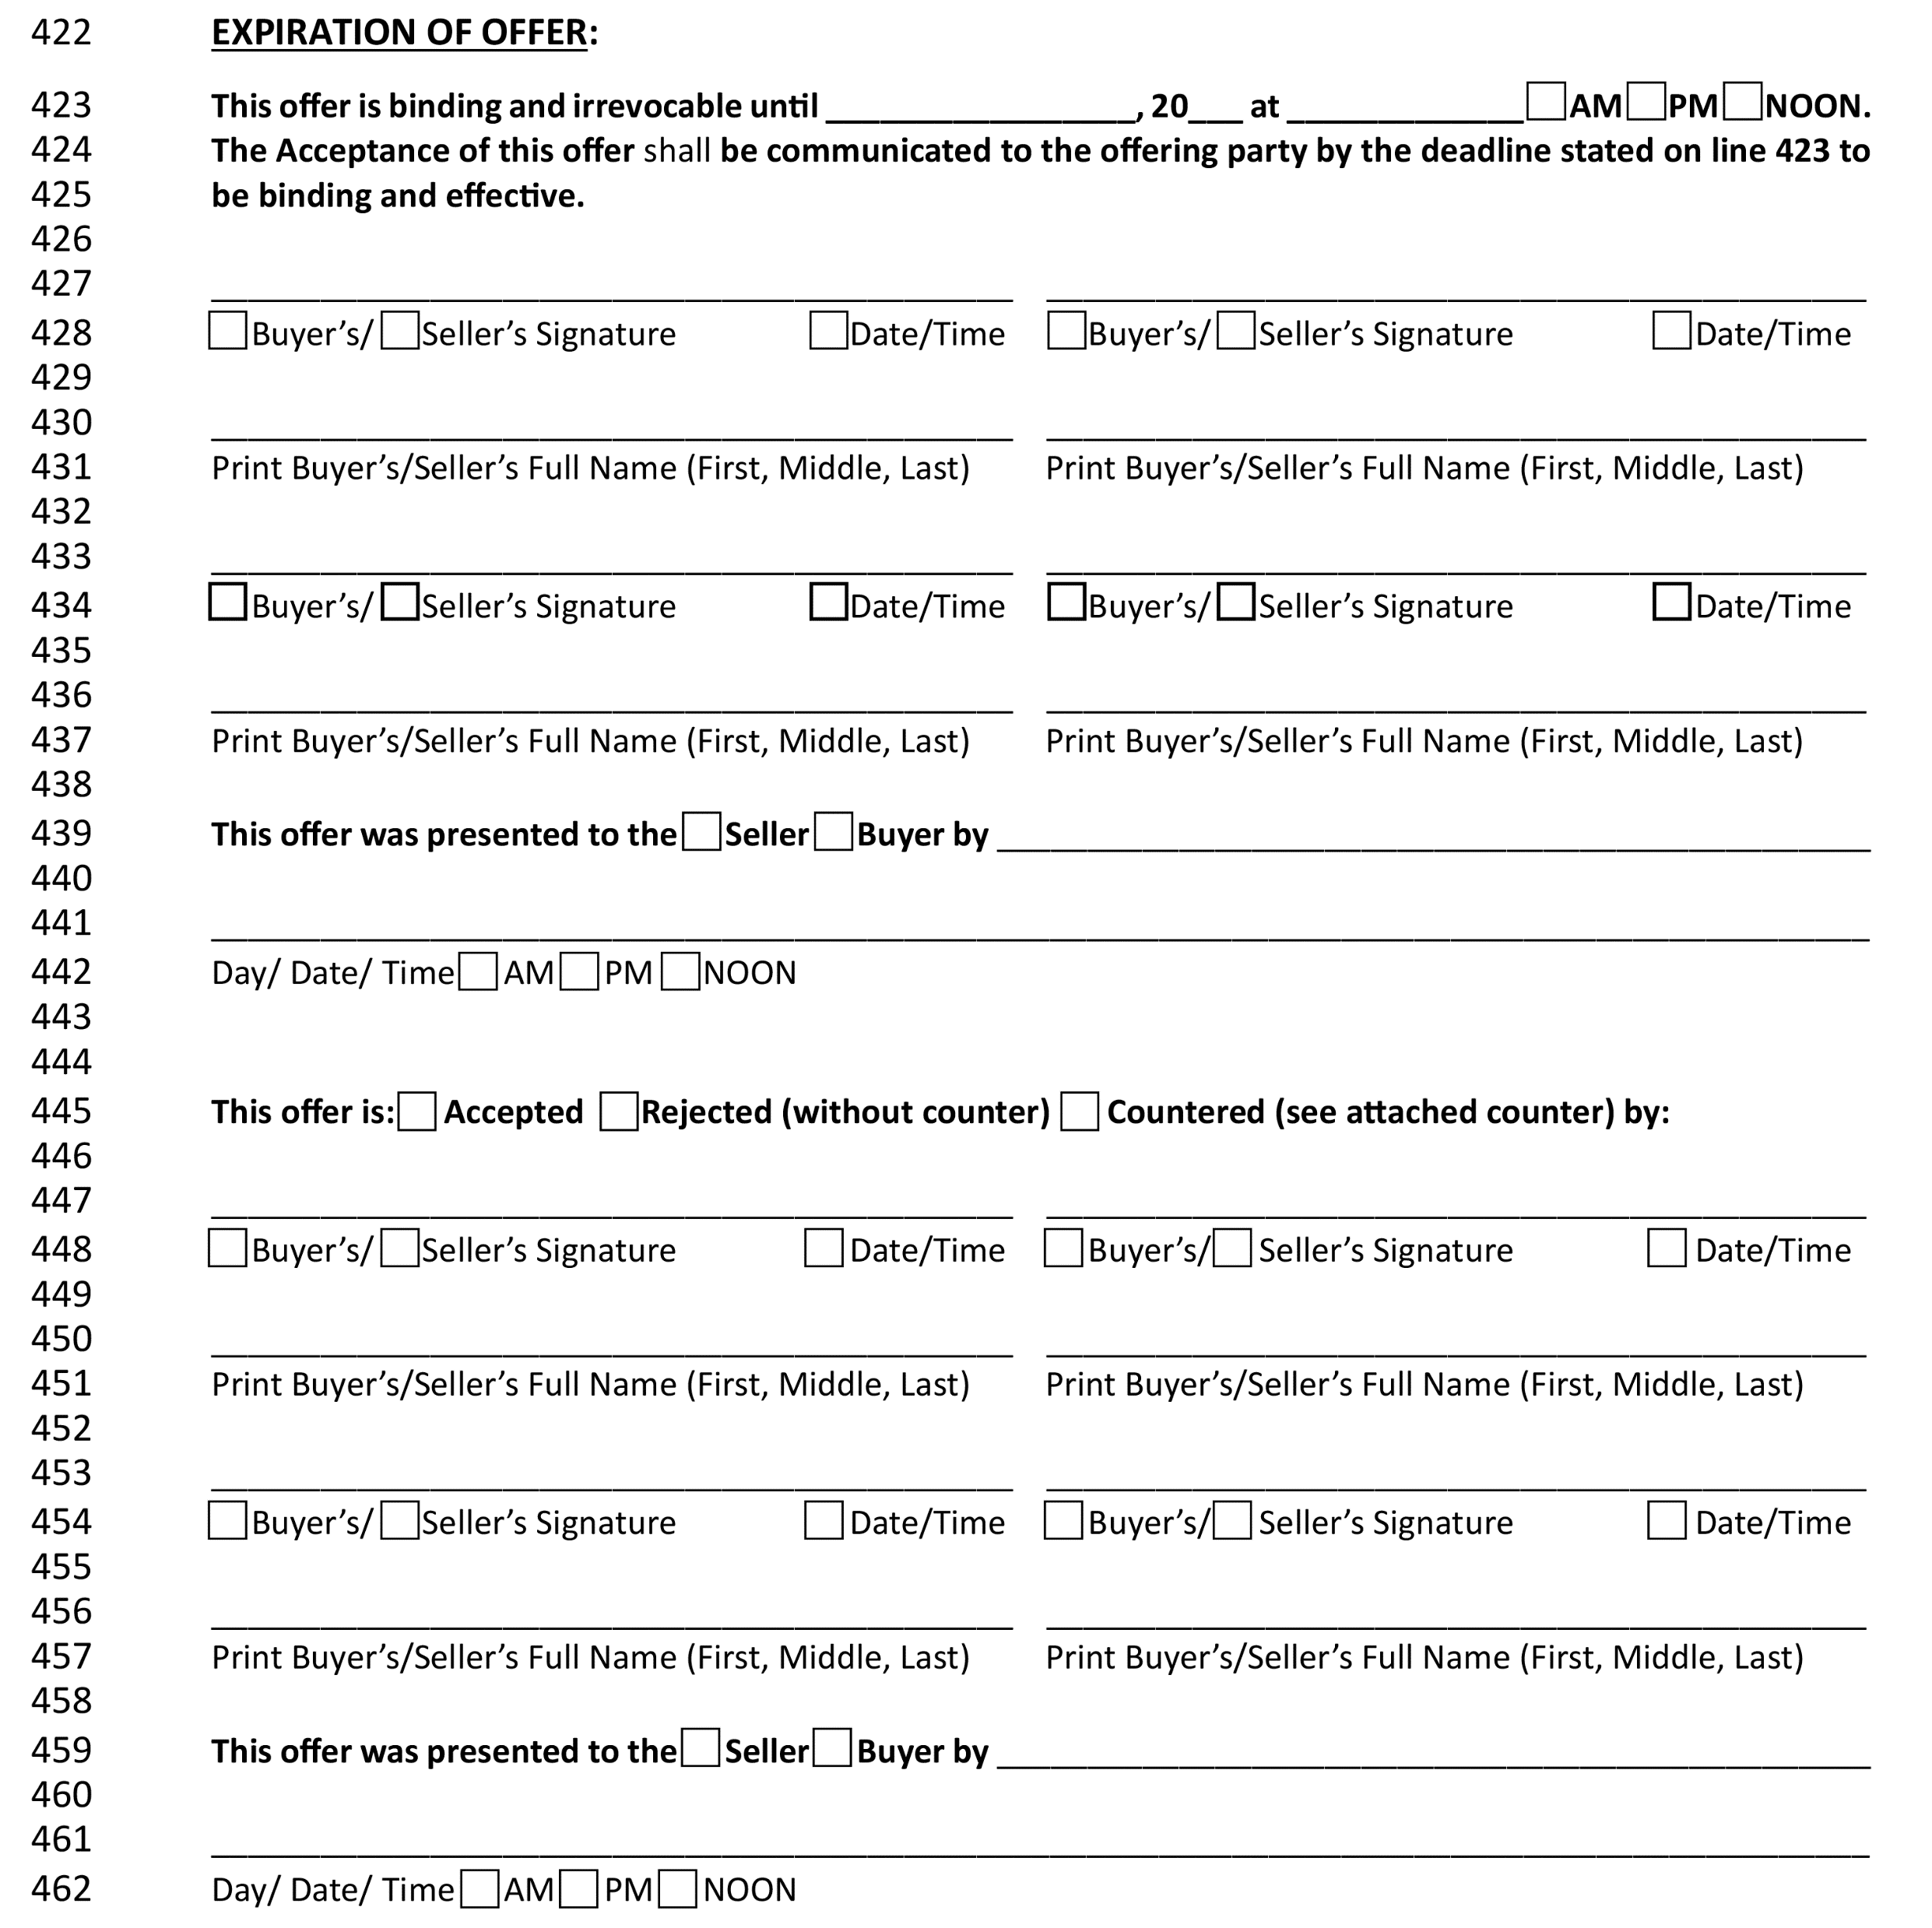
Notes:
You will notice that line numbers have been included all the way through the contract to the very end. This should be extremely helpful when referencing signatures and other information here at the end of the last page.

Slide 74
Module 3
CURRENT TRENDS

Slide 75
USING FINANCING CLAUSE AS OUR GUIDE

Slide 76
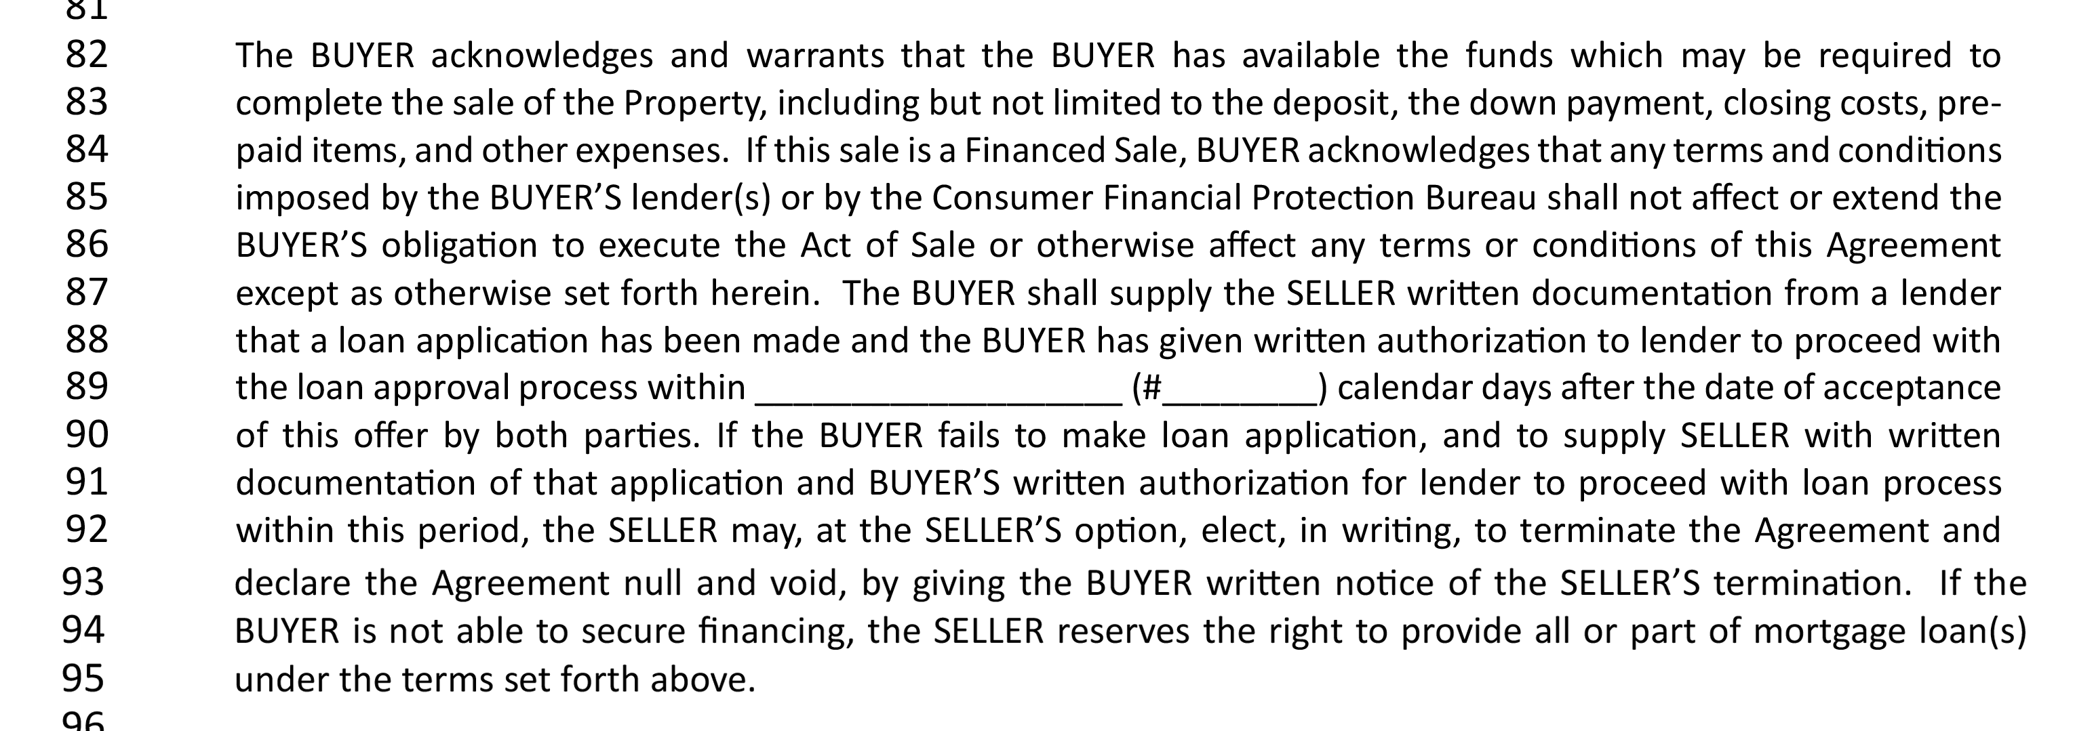
Notes:
Often overlooked on the Residential Agreement to Buy or Sell is a simple yet powerful term on lines 93-95 within the Financing Clause. It states “If the BUYER is not able to secure financing, the SELLER reserves the right to provide all or part of mortgage loan(s) under the terms set forth above

Slide 77
CURRENT MARKET IMPLICATIONS

Slide 78
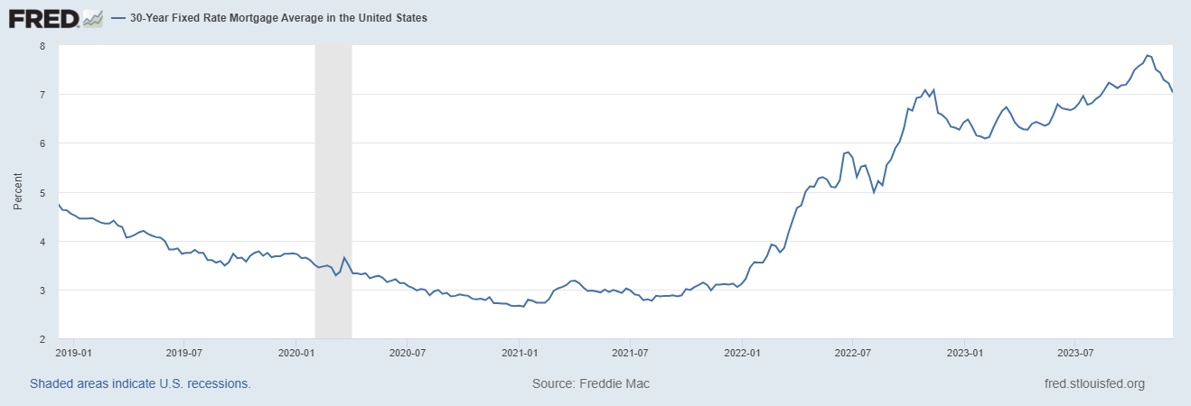
SOURCE: St. Louis Federal Reserve
Notes:
As just about anyone working in real estate has noticed, interest rates on mortgage loans have skyrocketed over the past two years. In late 2021, the national average for mortgage rates was approximately 3.15% for thirty-year fixed mortgages. Some prime borrowers, depending on credit and location, were even able to lock in sub 3% rates for a period of thirty years.
Compare that with today’s rates, where the national average has maintained steady over 7% for thirty-year mortgages as of the date of this publication. As a licensee it is easy to understand how this dramatic increase in rates has materially impacted the residential real estate market.

Slide 79
OWNER FINANCING
INTRODUCTION
HOW IT WORKS
RELATE TO FINANCING CLAUSE
Notes:
Owner Financing is where the Seller (property owner) in a real estate transaction finances all or part of the purchase price of a property for the Buyer. In an owner financing transaction, the Seller and Buyer will agree to the amount to be financed, the down payment (if any), the term for the payment, whether a balloon payment will be involved, and the date of maturity (when all monies become due) amongst other terms.

Slide 80
BOND FOR DEED
INTRODUCTION
KEY CONCEPTS
DIFFERENCE FROM OWNER FINANCING
Notes:
The main difference a Bond for Deed has from owner financing is the fact that under a bond for deed, the Seller retains title to the Property until all payments are made. The Bond for Deed normally has a down payment, with the Buyer agreeing to make monthly installment payments to the Seller that after a certain point, the Bond for Deed has been fulfilled and the Seller will transfer title to the Buyer and conclude the transaction

Slide 81
Module 4
HOT TOPICS & CASE STUDIES

Slide 82
THE CLASS ACTION DECISION FALLOUT

Slide 83
REALITY OF REAL ESTATE POST SITZER/BURNETT
“I am not worried about this…”
“I will pay attention to it when the case is finished finished…”
“This doesn’t have anything to do with me, why should I care?”
“Real Estate Agents aren’t Big Tobacco; we didn’t intentionally do anything wrong. I don’t see how our industry would or should be punished “

Slide 84
THE VERDICT
$1,700,000,000
To place the size of this verdict in context –
this is the amount of a Powerball Lottery
jackpot won in October 2023!

Slide 85
WHY IT MATTERS
MAJOR IMPLICATIONS TO INDUSTRY STRUCTURE
ANTI-TRUST
LICENSEES SHOULD
BE AWARE
MONITOR DEVELOPMENTS
PREPARE
Notes:
Although it would be wonderful to just not have to pay attention to the potential ramifications of the Burnett decision and the litigation taking place across the country, real estate licensees are best served (and at their best) being informed, aware and ready to continue assisting their clients and customers, just as they always haveGiven the size and consequence of this case, Burnett is likely to be heavily litigated and appealed for the next few years. It is highly encouraged that all licensees stay up to date on the developments as things continue to evolve.

Slide 86
BEST PRACTICE SUGGESTIONS
BUYER REPRSENTATION AGREEMENTS (“BUYER-BROKER AGREEMENTS)
USE IS CURRENTLY NOT MANDATORY BY LAW
TIPS ON BUYER REPRESENTATION AGREEMENTS
Notes:
It is important for all real estate practitioners to not only learn about their use, but to adopt their use into their standard operating procedure while also informing clients and customers about what they are and what they do. Remember this is not the first time Buyer’s Agreements are being used; they are the standard and norm in many other states whose real estate industries are alive and thriving.
Some information and tips to remember when negotiating a Buyer’s Representation Agreement:
1.Although their use is not mandatory, this may become the standard, and now is the time to get comfortable with them and learn how to best negotiate them. Plus, having these agreements gives the agents clarity as to the scope of their representation and how they will be compensated. 2.Remember, this agreement does not just make the relationship clear for the agent; it also makes it clear for the Client as they now have the scope of their relationship with the licensee defined in writing. 3.Remember that payment and the terms of the agreement are negotiable! The parties to this agreement are free to negotiate its terms in any way they see fit. Each Client may be different and sizing up the Client pre-negotiation can go a long way. 4.Explain everything you can about the agreement. This may be the first time a Buyer has heard of a Buyer’s Representation agreement in Louisiana, so be ready to explain to the Buyer what it is, what it does and be ready to answer questions. 5. Transparency is key. Licensees should go into a buyer representation agreement negotiation informing their potential Clients that the licensee wants to make the entire process of purchasing real estate as transparent as possible, and that starts with this Buyer’s Representation Agreement. 6.There are advantages to exclusivity if the Buyer will allow it. Having an exclusive agreement gives the agent time to find property for their client without an open-ended timeline or the possibility of a quick trigger termination. These agreements do not have to be exclusive, so expect questions from clients as to the differences.

Slide 87
REDUCING RISK ON REOCURRING ISSUES

Slide 88
LIABILITY REVIEW – IN THE LAW
REDUCE RISK BY IDENTIFYING KEY ISSUES SUCH AS:
STAY WITHIN LEGAL AREA OF COMPETENCE
NEGLIGENT MISREPRESENTATION V. FRAUD
“AWARENESS” RULE
AGENT DUTIES CLIENT V. CUSTOMER
ACTUAL KNOWLEDGE
Notes:
Refer to manual for details on legal risks and rulings related to key issues.

Slide 89
CASE STUDIES

Slide 90
CASE STUDY EXAMPLES
REFER TO pp. 50 – 51 IN YOUR STUDENT MANUAL
Notes:
At this point in the course instructors should review and discuss the case study examples – allow licensees to identify the key concepts and relate them to what has been discussed in the course.

Slide 91
BEST PRACTICE SUGGESTIONS
BE COGNIZANT OF DETAIL IN DESCRIPTION
BE WARY OF SIZES AND MEASUREMENTS
TRUST YOUR CLIENTS – TO A POINT!
BEWARE OF THE EX-NEIGHBOR!

Slide 92
BEST PRACTICE AND AWARENESS – WHOLESALE PRACTICTIONERS
WHOLESALING DEFINED
LICENSED V. UNLICENSED
REAL ESTATE ACTIVITY
LESION

Slide 93
THE END

