Slide 1
Basics of Investment Property and Property Management
Notes:
Welcome students.

Slide 2
Course overview and objectives
Part 1
Investment Property
Discuss commercial real estate, including how investment property is valued and how investment decisions are made.
Part 2
Property Management
Examine the role of property management in complying with laws and maximizing the value of investment property.
Part 3
LREC Updates
Review LREC updates.
Notes:
Review course overview and objectives.

Slide 3
Course schedule
Course Introduction
Course Description and Objectives | 8:30-8:35
Introductions | 835-8:45
Part 1: Investment Property
Lesson 1: Overview of Commercial Real Estate | 8:45-9:00
Lesson 2: Determining Values of Investment Properties | 9:00-9:15
Lesson 3: Resources for Decision-Making | 9:15-9:30
Lesson 4: Data for Decision-Making | 9:30-9:45
Case Study Part 1: Investment Property | 9:45-10:00
Break #1 | 10:00-10:15
Notes:
Explain the course schedule.

Slide 4
Course schedule
Part 2: Property Management
Lesson 1: Overview of Property Management | 10:15-10:45
Lesson 2: Property Management in Louisiana | 10:45-11:30
Lesson 3: Key Federal Laws | 11:30-11:45
Lesson 4: Property Management Best Practices | 11:45-12:10
Property Management Case Study | 12:10-12:40
Part 3: Louisiana Real Estate Commission Update
LREC Update | 12:40-1:10
Notes:
Explain the course schedule.

Slide 5
Introductions
Name
Location and role
Real estate experience
What are you hoping to learn?
Notes:
Conduct introductions.
Review course logistics items, including:
Sign-in and out
Restrooms
Breaks
Emergency exits

Slide 6
Part 1 Investment Property
Notes:
Introduce Part 1 – Investment Property.

Slide 7
Commercial Real Estate Investing
Overview of Commercial Real Estate
Determining Values of Investment Properties
Resources for Decision Making
Data for Decision Making
Case Study Part 1: Investment Property
Notes:
Review the lessons in Part 1 – Investment Property.

Slide 8
Overview of Commercial Real Estate
Lesson 1
Notes:
Introduce the lesson.
Explain the following in your own words:
Learning objective:
List the characteristics of each investment property type: single family dwelling, duplex or four plex, and office buildings
Topics:
Property type markets
Single family dwelling
Duplex or four plex
Office buildings
Introduction of office building case study

Slide 9
Overview of Commercial Real Estate
Property Type Markets
Single Family dwelling
Duplex – Fourplex
Office Buildings
Notes:
Discuss the property type markets.

Slide 10
Single Family, Duplex-Fourplex
Easiest rental property to attain
Demand is more stable than in other property types because people need a place to live even if they have temporarily lost their job.
Vacancies can generally be refilled without significant costs.
Shorter term leases (typically 1 year) allow the owner to adjust rents to market prices more frequently, which is especially helpful in a rising market.

Slide 11
Office Buildings
Office properties are occupied for a variety of business purposes.
The term “office” can refer to entire buildings, floors, parts of a floor or office parks.
Office buildings can be built-to-suit for a user’s unique operational needs.
The Building Owners and Managers Association (BOMA, http://www.boma.org/) differentiates offices by several ways.

Slide 12
Office Buildings
Low-rise: Fewer than seven stories above ground level
Mid-rise: Between seven and 25 stories above ground level
High-rise: More than 25 stories above ground level
Class A
Class B
Class C

Slide 13
Office Buildings
A portion of a multi-tenant building consists of common areas that include lobbies, hallways, janitor closets and restrooms.
A user must pay for their proportion of the common areas shared with the other occupants of the floor and/or building.

Slide 14
Office Buildings
Measuring Office Space:
Useable Square Footage versus Rentable Square Footage
Common area expenses shared by tenants on a pro-rata basis
Common Area

Slide 15
Case Study
Dee Breaux is the broker for Tiger Realty in Baton Rouge. Her newest clients, Joe and Lisa Burreaux, are in the market for an investment property near LSU campus. Dee finds them the perfect University Place four-plex near campus, and the Burreauxs love the property as a rental investment opportunity!

Slide 16
Case Study, Income
Apartment A – $500 / month
Apartment B – $475 / month
Apartment C – $550 / month
Apartment D – $600 / month

Slide 17
Case Study, Expense
Insurance – $1,800 / year Taxes – $1,500 / year Landscaping – $150 / month. Association Fees – $200 / month. Property Management – 10% / month. All tenants are required to pay their own unit’s utility expenses.

Slide 18
Case Study, Expense
What is the highest dollar amount the Burreauxs can pay for the University Place four-plex if they want to receive a TEN PERCENT (10%) minimum return on investment?

Slide 19
Determining Values of Investment Real Estate
Lesson 2
Notes:
Introduce the lesson.
Explain the following in your own words:
Learning objective:
List the characteristics of each investment property type: single family dwelling, duplex or four plex, office buildings, and industrial/warehouse
Topics:
Property type markets
Single family dwelling
Duplex or four plex
Office buildings
Industrial and warehouse
Introduction of office building case study

Slide 20
Determining Values of Investment Properties
Sales Comparison
Cost Approach
Income Approach
Gross Rent Multiplier
Capitalization Rate
Net Operating Income
Annual Property Operating Data Form

Slide 21
Sales Comparison
The use of sales of comparable properties to estimate the value of the property being valued (called the subject property).
Prices are usually divided by the number of square feet or some other measure of size or utility (cubic feet, front feet, etc.).
Adjustments to each of the comparable sales are made for differences in factors such as age, location, time of sale, etc.

Slide 22
Cost Approach
The cost of replacing the property with a new property that has the same utility to the user
If the property being valued is not new, then depreciation is deducted from the replacement cost to reflect physical wear and tear, poor or outdated design, and any loss in value that might result if the property is at a location where it would not be built in the current market.
Finally, the value of the land is added to get a total value.

Slide 23
Gross Rent Multiplier (GRM)
To Determine Value
GRM X Forecast 1st year Potential Rental Income (PRI) = Investment Value
To Determine GRM
Investment Value / Year 1 PRI = GRM

Slide 24
Gross Rent Multiplier (GRM)
If a property is forecasted to have $25,500 first-year PRI and the potential buyer’s GRM requirement is seven, what is the investment value of the property?
$25,500 x 7 = $178,500
$178,500 is the amount that this potential buyer would consider paying for this property using GRM to calculate investment value.

Slide 25
Income Capitalization
Converting one year’s income into a value
Applying a Capitalization Rate to the Net Operating Income of a property projected for the next year (Direct Capitalization).

Slide 26
Income Capitalization
Value = Income / Rate
Where:
I = Income (NOI)
R = Rate (cap rate)
V = Value

Slide 27
Income Capitalization
Value = Income / Rate
An investor is considering purchasing a property with a forecasted first year NOI of $50,000. The investor has established a cap rate requirement of 9.75 percent based on similar properties.
What would this investor consider paying for the property?
How to solve:
I ($50,000) ÷ R (0.0975) = V ($512,821)
The investor will consider paying $512,821 for this property using the capitalization rate of 9.75 percent to determine investment value.

Slide 28
Income Capitalization
Value = Income / Rate
The key to good capitalization rates is understanding the definition of Net Operating Income.

Slide 29
Income Capitalization
Net Operating Income Formula
Potential Rental Income
Vacancy
Operating Expenses
= Net Operating Income
The complete process is found on an Annual Property Operating Data form.

Slide 30
Annual Property Operating Data Form

Slide 31
Resources for Decision Making
Lesson 3
Notes:
Introduce the lesson.
Explain the following in your own words:
Learning objective:
List the characteristics of each investment property type: single family dwelling, duplex or four plex, office buildings, and industrial/warehouse
Topics:
Property type markets
Single family dwelling
Duplex or four plex
Office buildings
Industrial and warehouse
Introduction of office building case study

Slide 32
Resources for Decision Making
Due Diligence
Purchase Agreements
Disclosures
Inspections
Licenses needed

Slide 33
Resources for Decision Making

Slide 34
Purchase Agreements
Identify buyer
Identify seller
Identify property
Identify deed
Identify title policy
Identify purchase price
Identify deposit amount

Slide 35
Purchase Agreements
Identify buyer’s agent
Identify seller’s agent
Identify title company
Identify settlement
Identify closing information

Slide 36
Purchase Agreements
Confirm brokerage fees
List seller disclosures
Identify buyer’s due diligence and right to cancel
Estoppel certificates
Condition of property

Slide 37
Disclosures
Err on the side of “over” disclosing
CRE does not typically use residential disclosure forms

Slide 38
Inspections
Financial
Building
Reports

Slide 39
Inspections
Financial
Review Rental Agreements
Review Leases
Review Annual Operating Statement

Slide 40
Inspections
Financial
Review tax bills for past 3 years
Schedule of CapEx past 3 years
Schedule of tenant’s security deposits
Review utilities records
Current invoices for service contract providers and utilities
Review Insurance Quote
Copy of loss report from insurance company for last 3 years

Slide 41
Inspections
Building
Review Easement Agreements (if any)
Review Building Service Contracts (including leasing and property management)
Review Maintenance Log & CapEx
Warranties
Property Management Agreement
Contact Tenants & Create Contact List
Certificate of Insurance
Copies of all zoning and other governmental permits/ written confirmation

Slide 42
Licenses
Occupational License
Prior to opening for business, Tenant agrees to obtain all required governmental licenses and certificates and provide a copy of such to Landlord within thirty days of opening for business.

Slide 43
Licenses
Lease Commencement Date
The earlier of (a) when tenant opens for business or (b) the substantial completion Landlord’s work or (c) issuance of a temporary or permanent certificate of occupancy by the municipality.
Certificate of Insurance
Naming the Landlord and Property Manager as additionally insured: amount required will vary per Landlord.
Possible approval by the State Fire Marshal
Be sure to check with your local municipality for any possible additional local licensing requirements.

Slide 44
Data for Decision Making
Lesson 4
Notes:
Introduce the lesson.
Explain the following in your own words:
Learning objective:
List the characteristics of each investment property type: single family dwelling, duplex or four plex, office buildings, and industrial/warehouse
Topics:
Property type markets
Single family dwelling
Duplex or four plex
Office buildings
Industrial and warehouse
Introduction of office building case study

Slide 45
Data for Decision Making
Mortgage Loans
Real estate investments often are purchased using borrowed funds. The legal document that secures the repayment of these borrowed funds is called a mortgage.

Slide 46
Financing
Leverage
Financial leverage measures the degree to which debt is used to finance an investment.
This usually is done by investors to increase their expected return on equity.
As leverage increases, the investor is using more debt relative to equity.
The most common measure of Leverage is “Loan to Value.”

Slide 47
Leverage, Pros
Insufficient capital to pay all cash
Buy a property whose value exceeds available capital
Portfolio diversity to reduce risk
Buy several properties using debt financing instead of one for all cash
Increase return on equity
Favorable leverage will result in an equity yield that is greater than the unleveraged property yield
Tax deductibility of interest
The after-tax impact of leverage is usually greater than the before-tax impact

Slide 48
Leverage, Cons
Loan could cost more than the property yields
Could lose property in bad times
The lender will have a say in the operations of the property

Slide 49
Part 1: Investment Property
Case Study

Slide 50
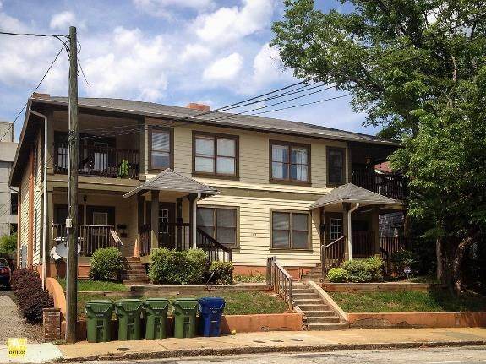
Case Study
Dee Breaux is the broker for Tiger Realty in Baton Rouge. Her newest clients, Joe and Lisa Burreaux, are in the market for an investment property near LSU campus.
Dee finds them the perfect University Place four-plex near campus, and the Burreauxs love the property as a rental investment opportunity!
This work by Sightline Institute Modest Middle Homes Library is licensed under a Creative Commons Attribution 4.0 International License.

Slide 51
Case Study, Income
Apartment A – $500 / month
Apartment B – $475 / month
Apartment C – $550 / month
Apartment D – $600 / month

Slide 52
Case Study, Income
Apartment A – $500 / month X 12 = $6,000
Apartment B – $475 / month X 12 = $5,700
Apartment C – $550 / month X 12 = $6,600
Apartment D – $600 / month X 12 = $7,200
Monthly Income $2,125
Annual Income $25,500

Slide 53
Case Study, Expense
Insurance – $1,800 / year
Taxes – $1,500 / year
Landscaping – $150 / month
Association Fees – $200 / month
Property Management – 10% / month
All tenants are required to pay their own unit’s utility expenses.

Slide 54
Case Study, Expense
Insurance – $1,800 / year
Taxes – $1,500 / year
Landscaping – $150 / month X 12 = $1,800
Association Fees – $200 / month X 12 = $2,400
Property Management – 10% / month = $212.50 X 12 = $2,550
All tenants are required to pay their own unit’s utility expenses.

Slide 55
Case Study, Annual Expense
Insurance $1,800 Taxes $1,500 Landscaping $1,800 Association Fees $2,400 Property Management $2,550
Total Expenses $10,050

Slide 56
Case Study, NOI
Annual Income $25,500 Total Expenses $10,050
Net Operating Income $15,450

Slide 57
Case Study, Expense
What is the highest dollar amount the Burreauxs can pay for the University Place four-plex if they want to receive a TEN PERCENT (10%) minimum return on investment?

Slide 58
Income Capitalization
Value = Income / Rate
Where:
I = Income (NOI)
R = Rate (cap rate)
V = Value

Slide 59
Case Study, Expense
What is the highest dollar amount the Burreaux’s can pay for the University Place four-plex if they want to receive a TEN PERCENT (10%) minimum return on investment?
Income / Rate = Value
$15,450 / 10% = $154,500
The Burreaux’s can pay $154,500 and get a 10% return on their investment.

Slide 60
Key takeaways
Part 1
Notes:
Review key takeaways for Part 1.
Ask students to share their insights.
What did they learn?
What areas covered would they like to know more about?
Where will they seek additional information and education?

Slide 61
Part 2 Property Management
Notes:
Introduce Part 2 – Property Management.

Slide 62
Overview of Property Management
Lesson 1
Notes:
Introduce the lesson.
Explain the following in your own words:
Learning objective:
By the end of this lesson, you will be able to:
Describe the roles and responsibilities of a property manager
Topics:
Overview
Roles and Responsibilities
Management Company

Slide 63
Property management is a professional activity in which someone other than the owner supervises the operation of a property according to the owner’s objectives.
Property management is the operation of income-producing real estate as a business, including leasing, rent collection, maintenance of the property, compliance with laws and regulations, and general administration.
Notes:
Review the definition of property management.

Slide 64
The property management company
In-house
Internal function for a company that has ownership control of real estate
Third-party
External function
Also referred to as third-party fee management or fee management
Notes:
Ask:
What’s the difference between in-house and third-party management?
Poll the class to see who knows these different relationships.
Stress that the skills and knowledge needed are identical in either situation. Each management function will do business a little bit differently, but when managing their properties, they all have the same purpose: to manage the building according to the goals of the owner and the policies and procedures of the management company compliant with the agreed upon terms of the management agreement between the company and the client (owner).

Slide 65
Property managers have a fiduciary responsibility to the owner
An agency relationship exists when a principal, the property owner, authorizes another person (the agent) to act on his/her behalf.
This is a legally recognized relationship based on management’s fiduciary responsibility, or acting in a reasonable and prudent manner for the benefit of an owner.
Notes:
Stress: Fiduciary doesn’t just mean saving money; it means spending it in the right way, too.

Slide 66
Fiduciary responsibility to the owner
The management company is entrusted to act in the owner’s best interests to safeguard the investment.
The property manager must advocate for the owner and think through the impact of decisions.
Notes:
Stress that the management company:
Is entrusted to act in the owner’s best interests to safeguard the investment.
Must advocate for the owner and think through the impact of decisions.

Slide 67
Key areas of responsibility
Budgeting and finance
Human resources
Maintenance and operations
Marketing and leasing
Owner’s objectives
Notes:
Introduce the different areas of responsibility.

Slide 68
Monitor and pay expenses
Prepare comprehensive budgets and cash flow projections
Increase the property’s value
Budgeting and finance
Notes:
Review responsibilities under budgeting and finance.

Slide 69
Evaluate staffing needs
Hire and train staff
Follow employment law
Administer other human resources activities
Human resources
Notes:
Discuss responsibilities under human resources.
Explain that property managers often must hire property staff.

Slide 70
Develop and administer maintenance plans
Oversee operation of building systems
Assess, minimize, and mitigate risk
Comply with laws and regulations
Implement sustainable operations
Develop emergency procedures plans
Other maintenance and operations functions
Maintenance and operations
Notes:
Review the maintenance and operations responsibilities of property managers.
Ask for other examples of maintenance and operations responsibilities, such as:
Implement changes and upgrades to property amenities.
Monitor and approve purchasing
Seek operational efficiencies that reduce operating expenses.
Manage contracts and contractors
Implement and manage record-keeping systems
Operate property management software
Other examples

Slide 71
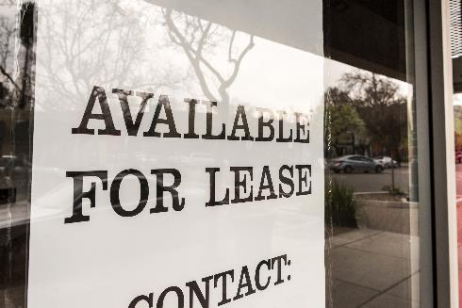
Develop and implement a marketing and leasing plan
Work with brokers to lease vacant space
Negotiate terms and leases
Administer the collection and deposit of rents
Anticipate and respond to tenants’ needs
Marketing and leasing
Notes:
Discuss the marketing and leasing responsibilities of property managers.

Slide 72
Meet the owner’s goals
Develop a management plan
Communicate with property owners and investors
Fulfill terms of management agreement
Owner’s objectives
Notes:
Discuss the responsibilities of property managers in meeting the owner’s objectives.

Slide 73
What do you think?
A property manager doesn’t have a clear understanding of the property owner’s objectives. Instead, they seek to maximize cash flow as their only management goal.
Why might this create issues with the owner?
Notes:
Facilitate a discussion on the importance of managing according to the owner’s objectives.
Emphasize:
Property budgeting, maintenance, marketing and leasing, staffing, and everything else flow from the owner’s objectives for their investment (e.g., investment hold period will impact nature of any property improvements).
The owner may have goals around maintenance of the property, equipment repair and replacement, sustainability, and other areas that require a clear understanding of their objectives.
You need to be able to provide accurate, complete info on property performance to the owner.
Surprises in cash flow and returns—including income beyond projections—could create undesirable positions for the owner (e.g., tax obligation)

Slide 74
Property-specific considerations
Management and operational issues will differ among the various property types
Hours of operation
Signage
Deliveries
Trash removal
Parking
Promotional events
Noise, sounds, odors
Security
HVAC & utility
Notes:
Review the property-specific considerations.
Ask:
How might each of these considerations differ by property type?

Slide 75
Management company
Strategy
Client relations
Business development
Governance and policies
Other functions depending on size, structure, etc.
Company finance and accounting

Slide 76
President/Owner
Sr. property manager
Head of facilities/
maintenance
Marketing staff (3)
Accounting staff (4)
Property manager (The James)
Property manager
(1100 Westwood)
Maintenance lead and staff (2)
Maintenance lead and staff (4)
Administrative assistant
Concierge
Administrative assistant
Notes:
Explain that this org chart is a simplified example of the structure of a management company.
Stress that this is simplified, although smaller firms may have something similar.
Point out that while all positions are employees of the management company, some are corporate staff while others are assigned to the properties under management.
Provide examples of more layers and positions, such as:
Corporate officers (e.g., VP of Marketing, VP of Training, VP of Property Management)
Regional operations staff
Additional property managers
Staff for other services provided by the management company

Slide 77
Other common property staff
Assistant property manager
May manage property inspections, day-to-day dealings with tenants, record keeping, and more
Janitor or porter
Groundskeeper
May be contracted or in-house
Tenant services staff
Security or courtesy patrol
May include door attendants, front desk clerks, other staff
Helps to mitigate crime activity and maintain safety
May sweep and mop, pick up clutter, clean amenities, and more
Notes:
Elaborate on each of these roles.
Share what these staff people do at properties you manage.

Slide 78
Q.
When do property managers use contractors?
A.
Staff availability
Short-term project
Staff does not have necessary skills
Special equipment/materials required
Licensed technicians required
More cost effective/efficient
Materials and supplies not available
Urgent repair
Notes:
Explain that contractors play a key role in property operations.
Review key reasons that property managers use contractors.

Slide 79
Q.
What do asset managers do?
A.
Work for the owner
Hire and oversee property management
Direct strategies to optimize financial performance of property
Evaluate potential capital investments in property
Recommend acquisition and disposition strategies
Property managers are often asked to perform functions of asset manager for smaller owners.
Notes:
Ask if anyone knows what an asset manager does.
Review the role and responsibilities of the asset manager.
Explain that property managers are often asked to perform asset management functions for smaller owners, especially in:
Directing strategies to optimize financial performance of property
Evaluating potential capital investments in property
Recommending acquisition and disposition strategies

Slide 80
Property management roles and responsibilities
Knowledge check
Notes:
Conduct the knowledge check in one of two ways:
Have students answer the questions in their student workbooks and then review as a class.
Answer the questions as a class by moving through the slides, asking for responses, and revealing answers.

Slide 81
1.
Which of the following activities is a property manager likely to engage in?
Design a building
Supervise a renovation
Meet with the property's owner
Change an air conditioner unit
Prepare a budget
Hire a leasing agent
Install new carpeting
Notes:
Read each task aloud and ask students to raise their hand if they think this is a task a property manager is likely to do.
Reveal the correct answers by advancing the slide animation.
Design a building: no
Supervise a renovation: yes
Meet with the property's owner: yes
Change an air conditioner unit: no
Prepare a budget: yes
Hire a leasing agent: yes
Install new carpeting: no

Slide 82
2.
fiduciary
A property manager has a _____________ responsibility to the owner and is entrusted to act in the owner’s best interest.
Notes:
Read the prompt.
Reveal the correct answer by advancing the slide animation.
Fiduciary

Slide 83
3.
Which of the following are key duties of property managers under human resources?
Hire management company leadership
Acquire new business
Hire and train property staff
Evaluate property staffing needs
Hire management company accounting staff
Follow employment law
Obtain necessary business permits
Notes:
Read each task aloud and ask students to raise their hand if they think this is a task a property manager is likely to do.
Reveal the correct answers by advancing the slide animation.
Hire management company leadership: no
Acquire new business: no
Hire and train property staff: yes
Evaluate property staffing needs: yes
Hire management company accounting staff: no
Follow employment law: yes
Obtain necessary business permits: no

Slide 84
4.
Which of the following are key duties of property managers under maintenance and operations?
Oversee operation of building systems
Fix a leaky skylight
Recommend property disposition strategies
Adjust controls on a boiler
Manage property design and construction
Prepare and oversee a maintenance plan
Implement an emergency procedures plan
Notes:
Read each task aloud and ask students to raise their hand if they think this is a task a property manager is likely to do.
Reveal the correct answers by advancing the slide animation.
Oversee operation of building systems: yes
Fix a leaky skylight: no
Recommend property disposition strategies: no
Adjust controls on a boiler: no
Manage property design and construction: no
Prepare and oversee a maintenance plan: yes
Implement an emergency procedures plan: yes

Slide 85
5.
Which of the following are key duties of property managers under owner’s objectives?
File the owner’s business taxes
Meet the owner’s goals
Develop a corporate strategy
Develop a management plan
Manage property design and construction
Hire management company leadership
Fulfill terms of management agreement
Notes:
Read each task aloud and ask students to raise their hand if they think this is a task a property manager is likely to do.
Reveal the correct answers by advancing the slide animation.
Oversee operation of building systems: yes
Fix a leaky skylight: no
Recommend property disposition strategies: no
Adjust controls on a boiler: no
Manage property design and construction: no
Prepare and oversee a maintenance plan: yes
Implement an emergency procedures plan: yes

Slide 86
6.
asset
Representing the owner, the ________ ___________ hires and oversees property management.
manager
Notes:
Read the prompt.
Reveal the correct answer by advancing the slide animation.
Asset manager

Slide 87
Property Management in Louisiana
Lesson 2
Notes:
Introduce the lesson.
Explain the following in your own words:
Learning objective:
By the end of this lesson, you will be able to:
Explain Louisiana laws and regulations that apply to property management
Topics:
Overview of Louisiana law
Broker supervision
Lease agreement
Trust accounts
Security deposits
Eviction proceedings and Notice to Tenants

Slide 88
“Property management” means the marketing, leasing, or overall management of real property for others for a fee, commission, compensation, or other valuable consideration.
“Property manager” means one who, for a fee, commission, or other valuable consideration, manages real estate, including the collection of rents, supervision of property maintenance, and accounting for fees received for another.
- Louisiana Real Estate License Law
Notes:
Review the definition of property management and property manager as it’s defined in Louisiana Real Estate License Law.

Slide 89
License law
Notes:
The first section in this lesson is on license law and property management in Louisiana.

Slide 90
Are property managers required to be licensed real estate brokers in the State of Louisiana?
Yes. Anyone who…”[s]ells, exchanges, purchases, manages, rents, or leases or negotiates the sale, exchange, purchase, rental, or leasing of real estate”
For more than one owner
Notes:
Explain that a license is required when a property manager manages property for more than one owner.

Slide 91
When is a broker license not required?
Under sponsoring broker supervision:
Deliver, receive, and execute leases
Receive payments
Show rental units
Carry out administrative, clerical, and maintenance tasks
Notes:
Review the cases in which a broker license is not required to perform property management functions.
Inform students that owners are also not required to hold a license.

Slide 92
Management agreement
Notes:
The next section is on management agreements.

Slide 93
Management agreements
Written authorization from property owner(s) to manage property
Notes:
Explain that management agreements establish the owner-authorized agent relationship.

Slide 94
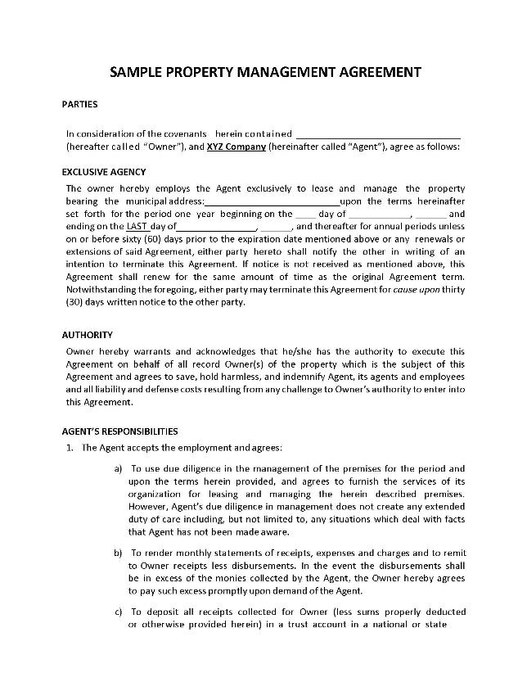
Required management agreement clauses
Duties and responsibilities
Authorities and powers
Management fee
Period of agreement
lrec.gov
Notes:
Review the required management agreement clauses.
Direct students to LREC.gov for a sample management agreement.

Slide 95
Landlord and tenant law
Notes:
This section is landlord and tenant law.

Slide 96
Landlord responsibilities
To deliver the property to the tenant at the agreed time and in good condition
To maintain the property in a suitable condition
To protect the tenant’s right of peaceful possession for the duration of the lease
To refrain from making any alterations to the property
To pay taxes, assessments, and other charges to the property

Slide 97
Tenant responsibilities
To pay the rent in accordance with the lease terms
To return the property in the same condition as it was leased, except for normal “wear and tear”
To refrain from altering the premises without first obtaining written consent from the landlord
To allow the landlord to make all necessary repairs that cannot be postponed until the end of the lease
To use the property for the purpose for which was leased. Any misuse by the tenant may cause the lease to be dissolved
To inform the landlord promptly when the property has been damaged or needs repair
The tenant is liable for damages to the property that exceed the normal “wear and tear” caused by the tenant or the tenant’s guests.

Slide 98
Security deposits
No specified limit – 1-2 months’ rent is common
30 days to return deposit after tenant moves out
Landlord must send to tenant forwarding address
Itemized statement of deductions required
Notes:
Explain the requirements around security deposits.
No specified limit – 1-2 months’ rent is common
30 days to return deposit after tenant moves out
Landlord must send to tenant forwarding address
Itemized statement of deductions required

Slide 99
Security deposit deductions
Unpaid rent
Defaults (e.g., unpaid electricity bill)
Damage in excess of “normal wear and tear”
Other breaches of lease
Notes:
Review the examples of permissible security deposit deductions.

Slide 100
ag.state.la.us/Resources
Notes:
Direct students to the Louisiana Attorney General guide on landlord and tenant laws.

Slide 101
Required disclosures
Notes:
This section is on required disclosures.

Slide 102
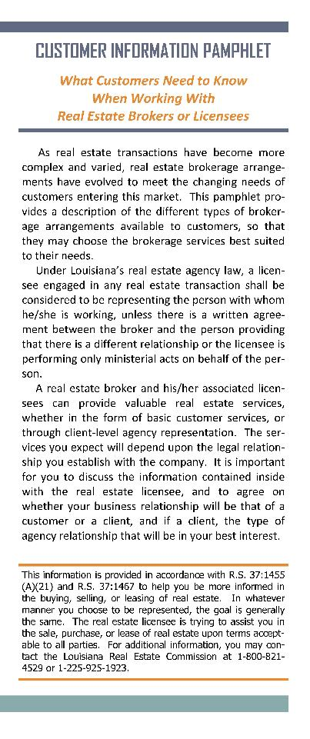
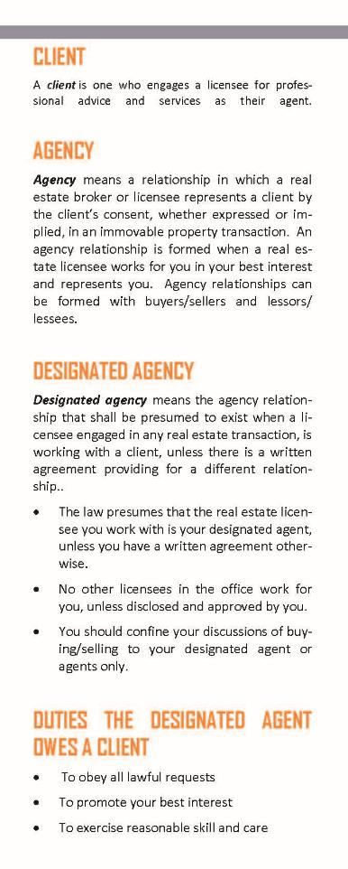
Required disclosure #1
Agency
Pamphlet or form
Signed acknowledgement of receipt
Record retention – 5 years

Slide 103
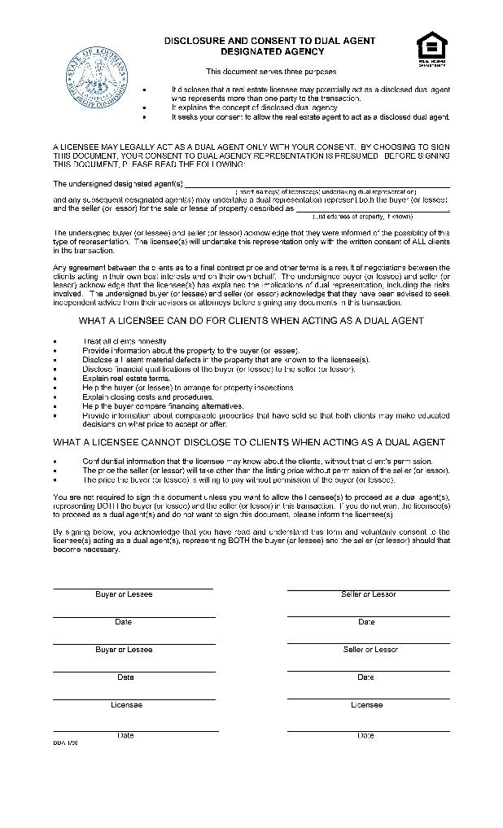
Required disclosure #1
Dual agency
Separate form

Slide 104
Required disclosure #2
Mold
U.S. EPA pamphlet or website

Slide 105
Required disclosure #3
Registered sex offenders
Megan’s Law
Notice of public access to statewide database disclosing locations
Phone
Internet
Source: New Orleans Metropolitan Association of REALTORS®

Slide 106
Landlord trust checking accounts
Notes:
This section covers landlord trust checking accounts.

Slide 107
Rental account
“Rental Trust Account” on all checks and statements
Security deposit account
“Security Deposit Trust Account” on all checks and statements
Financial institution in state of Louisiana
Titled in identical wording as broker’s license
Fees may be paid from accounts
Accounts need not be interest-bearing

Slide 108
Trust accounts
Multiple properties and owners in same account okay
Ledger for each property

Slide 109
Lease termination and eviction
Notes:
This section is on lease termination and eviction.

Slide 110
Lease periods
Fixed-term
No term/month-to-month
Typically a year
Can be any time period not to exceed 99 years
If no duration specified, lease is month-to-month

Slide 111
Notice to Vacate
Fixed-term
No term/Month-to-month
Landlord must send written notice more than 30 days prior to end of lease term
Landlord must send written notice at least 10 days prior to end of month

Slide 112
Notice to Vacate
Tenant must get no less than 5 business days from date of delivery of notice to vacate premises

Slide 113
Eviction process
Notice to Vacate
Eviction filing
Eviction judgment
Physical eviction
5 days to vacate
Court proceeding no fewer than 3 days after tenant served
24 hours to vacate
Must be conducted by law enforcement
Notes:
Emphasize that property management should consult a qualified attorney throughout the eviction process.

Slide 114
Past due rent
Landlord may file separate suit
If tenant can’t be located, landlord may be able to seize property – consult an attorney

Slide 115
Other lease termination issues
Military termination rights
Notes:
Explain military termination rights.
Military
Active members of Armed Forces, including National Guard
Orders to depart 35 miles or more from the location of the dwelling for more than 3 months
Discharged, released, or retires.
Ordered to reside in government-supplied quarters.
Notified of availability of government-supplied quarters which were not available at time lease was executed (landlord must be notified in writing that he/she had a pending request for the government-supplied quarters before signing the lease)
Injured due to service in the armed forces and hospitalization required for more than 15 days
Killed in the line of service
Member must provide written notice of termination of lease, with a termination date not less than 30 days after the notice is served on landlord
Member or spouse must also provide proof of the hospitalization or death of the member if that is the reason for the termination of the lease

Slide 116
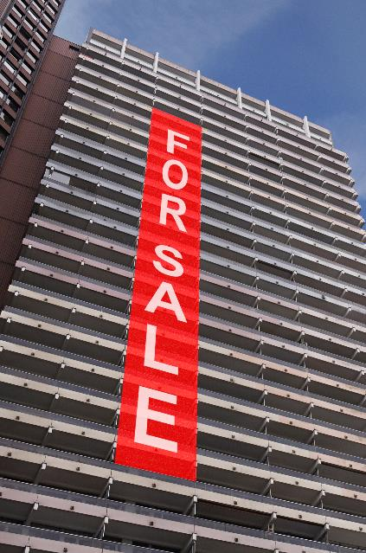
Other lease termination issues
Ownership changes
Notes:
Explain lease termination issues around ownership changes.

Slide 117
Key Federal Laws
Lesson 3
Notes:
Introduce the lesson.
Explain the following in your own words:
Learning objective:
By the end of this lesson, you will be able to:
Explain federal laws and regulations that impact property management
Topics:
Fair Housing Act (including emotional support animals, service animals)
Sherman Antitrust Act
Lead Based Paint Hazard Reduction Act
Equal Credit Opportunity Act
Americans with Disabilities Act
Uniform Residential Landlord and Tenant Act

Slide 118
Fair Housing Act
Equal Credit Opportunity Act
Sherman Antitrust Act
Americans with Disabilities Act
Lead Based Paint Hazard Reduction Act
Uniform Residential Landlord and Tenant Act
Notes:
Introduce the laws covered in this lesson.

Slide 119
Fair Housing Act
Equal Credit Opportunity Act
Sherman Antitrust Act
Americans with Disabilities Act
Lead Based Paint Hazard Reduction Act
Uniform Residential Landlord and Tenant Act
Notes:
Introduce the Fair Housing Act, the first law covered.

Slide 120
Section VIII of the Civil Rights Act of 1968, amendments in 1974 and 1988
Federal Protected Classes include:
Renters Can Really Sue Now For Housing Violations | Race: Caucasian, Black, Hispanic, etc. Color: skin color or pigmentation Religion: Catholic, Muslim, etc. Sex: gender, sexual harassment National origin: immigrant origin Familial status: children or pregnancy Handicap: physical or mental disability
Notes:
Explain that following fair housing laws is an important component of residential property operations.
Stress the importance of reviewing these laws regularly, even if regular training is also required.
Ask: Which property staff must be trained on fair housing laws? All!

Slide 121
Different treatment
Treating people from protected classes differently, either intentionally or unintentionally
Disparate impact
A neutral-appearing action or policy that applied equally to everyone still results in a negative impact on some classes
Types of discrimination
Notes:
EXPLAIN that the most common allegation of fair housing violation is discrimination due to different treatment, such as the refusal to rent to a prospect based on a protected class.
ASK:
What’s the difference between different treatment and disparate impact?
Who can share an example of each?
DIRECT students to the list of discriminatory behaviors in the supplemental text.
STRESS that fair housing laws impact almost every aspect of the leasing process and must be followed in all aspects of daily operations. It is wise to seek advice of legal counsel regarding specifics to ensure compliance.

Slide 122
Reasonable accommodation
Changes to policies and procedures to give disabled equal housing opportunity
Reasonable modification
Physical changes to the property to allow disabled full use of the premises
Notes:
Explain that under provisions of the 1988 FHA Act, a property owner cannot refuse to permit a resident with a disability to modify the leased premises at his or her own expense, as long as the modifications are necessary to allow full enjoyment of the premises. Nor can the owner refuse to implement reasonable rules and policies that will allow a disabled person the same right to use and enjoy the dwelling as residents who are not disabled.
Ask:
What’s the difference between reasonable accommodation and reasonable modification?
Who can share an example of each?

Slide 123
Louisiana Equal Housing Opportunity Act deemed substantially equivalent to federal Fair Housing Act

Slide 124
Fair Housing: Key Issue

Slide 125
“Assistance animals are not pets. They are animals that do work, perform tasks, assist, and/or provide therapeutic emotional support for individuals with disabilities.
There are two types of assistance animals: (1) service animals, and (2) other animals that do work, perform tasks, provide assistance, and/or provide therapeutic emotional support for individuals with disabilities (referred to in this guidance as a “support animal”).”
- U.S. Department of Housing and Urban Development (HUD)
Notes:
Review the HUD definition of an assistance animal, which includes both an animal that:
Perform tasks for a person with a disability
Provides emotional support that alleviates effects of a disability

Slide 126
January 2020 HUD guidance on assistance animals
Guidance that specifies only dogs (and in some cases miniature horses) as support animals applies to ADA situations, not Fair Housing
Fair Housing law requires reasonable accommodation for requests that involve many types of animals
Multiple animals: Same Fair Housing guidance, considerations, and procedures apply

Slide 127
Requests for assistance animals
Allow despite no-pets policy
Waive pet deposits and pet rents
Property management may request documentation if the disability and the disability-related need for the animal is not apparent.
Government document
Health care professional
Notes:
Remind students that they must make reasonable accommodations for persons with disabilities.
Review the reasonable accommodations typically required with assistance animal requests.
Explain that property management may request information on the disability and need for the assistance animal, if the disability-related need is not apparent.

Slide 128
Requests for assistance animals
For property management, disability-related information should only answer:
Is the prospect or resident a person with a disability?
Does the information on the disability meet the accepted definition of a disability?
Is the animal necessary to assist the prospect or resident with the disability?

Slide 129
Fair Housing: additional considerations
Citizenship status: Apply non-discriminatory screening procedures
Fair Housing assessment: Be prepared for “testers”; assess to ensure no discriminatory policies
Notes:
Review some additional fair housing considerations to keep in mind.
ASK:
Why is it potentially discriminatory to inquire about citizenship status?
How would you prepare for testers on your properties?
Explain citizenship status inquiries may be closely tied to national origin or religious discrimination. Many federally assisted properties require documentation of citizenship or immigration status to determine who is qualified to receive the subsidy in each household and HUD regulates guidelines. Managers and owners who plan to use similar measures must implement them uniformly for all applicants.
Direct students to the supplemental text for a fair housing assessment checklist.
Note that affordable housing properties must maintain wait lists for all current units and include name, contact information, date and time, etc.

Slide 130
What do you think?
Complying with Fair Housing requirements can be complex, especially since new issues constantly arise, and interpretation of the law continues to evolve.
What strategies are essential to helping property management companies comply with Fair Housing laws?
Notes:
Facilitate a discussion on what property management companies do to comply with Fair Housing laws.
Advance to the next slide to emphasize:
Company policies and procedures
Ongoing training for ALL site staff
Qualified legal counsel

Slide 131
Critical to Fair Housing compliance
Policies and procedures
Ongoing training
Legal counsel
Notes:
Emphasize:
Company policies and procedures for employees to follow and to maintain consistency. They should be followed uniformly – in the same way to each prospect/resident.
Ongoing training for ALL site staff
Qualified legal counsel

Slide 132
Fair Housing Act
Equal Credit Opportunity Act
Sherman Antitrust Act
Americans with Disabilities Act
Lead Based Paint Hazard Reduction Act
Uniform Residential Landlord and Tenant Act
Notes:
Introduce the Sherman Antitrust Act, the second law covered.

Slide 133
Sherman Antitrust Act and property management
Do not discuss management fees – no dollars or percentages
You may discuss fees with clients or prospective clients

Slide 134
Fair Housing Act
Equal Credit Opportunity Act
Sherman Antitrust Act
Americans with Disabilities Act
Lead Based Paint Hazard Reduction Act
Uniform Residential Landlord and Tenant Act
Notes:
Introduce the Lead Based Paint Hazard Reduction Act, the third law covered.

Slide 135
Requirement #1
EPA-approved pamphlet

Slide 136
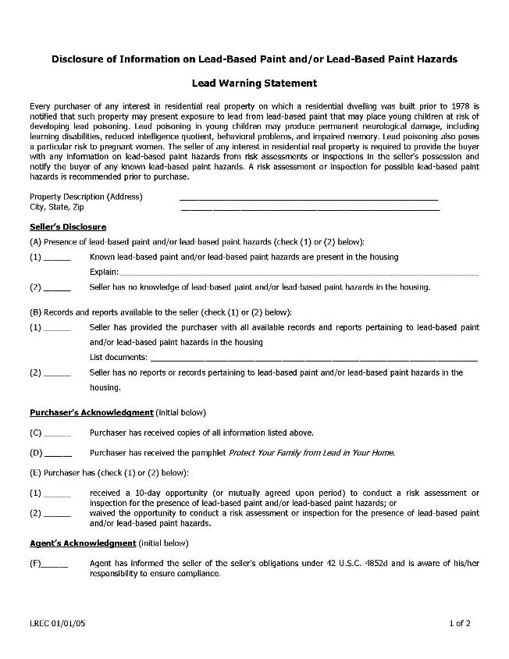
Requirement #2
Disclosure
lrec.gov
Notes:
Show the LREC disclosure form, available at lrec.gov.

Slide 137
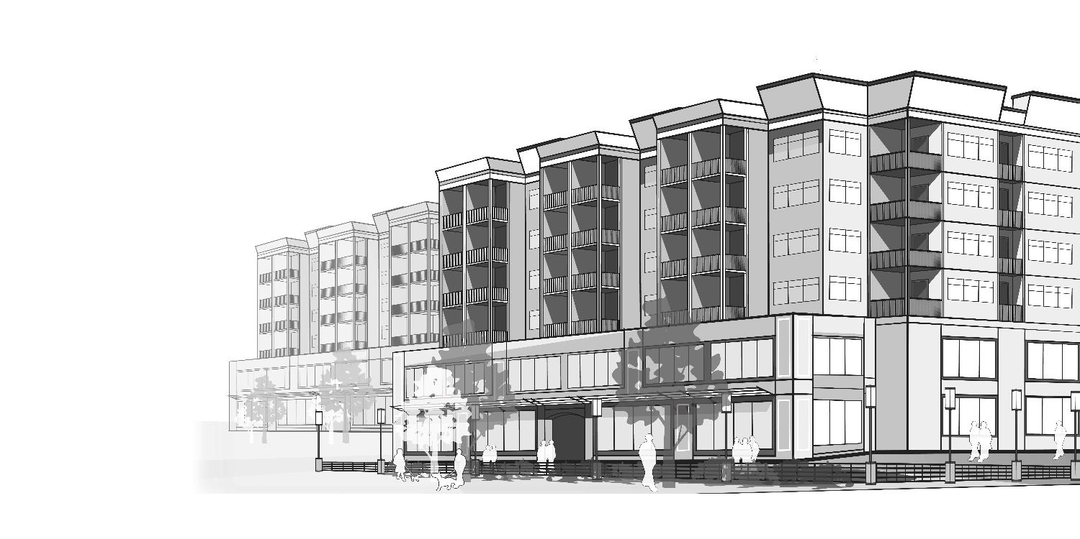
Commons areas and resident units
Notes:
Emphasize that in multifamily or multi-unit housing, lead paint disclosures must include information on hazards in both common areas AND resident units.

Slide 138
Requirement #3
Lead Warning Statement
lrec.gov
Notes:
Review the Lead Warning Statement.
Explain that this statement must be in the lease or as an attachment to the lease. The statement on the screen is included in the LREC disclosure form.

Slide 139
Fair Housing Act
Equal Credit Opportunity Act
Sherman Antitrust Act
Americans with Disabilities Act
Lead Based Paint Hazard Reduction Act
Uniform Residential Landlord and Tenant Act
Notes:
Introduce the Equal Credit Opportunity Act, the fourth law covered.

Slide 140
Equal Credit Opportunity Act
Discrimination is unlawful in any aspect of credit application on basis of:
Race
Color
Religion
National origin
Sex
Marital status
Age
Applicant's income from any public assistance program
Notes:
Review the Equal Credit Opportunity Act.
Ask: where else have we seen these protected classes? Similar to Fair Housing Act.

Slide 141
What do you think?
An owner of a multifamily community wants to deny rental applications from anyone who works on a freelance or contract basis, citing the unpredictability of income in these situations.
What should property management do?
Notes:
Facilitate a discussion on what property management companies should do in this situation.
Develop policies and procedures that apply rental application and approval consistently and uniformly.
Discuss with the owner situations in which they would accept freelance and contract income, since people increasingly have 1099 income and such a policy could exclude qualified renters. Examples include:
Documentation proving consistent income for a minimum period of time
Co-signer

Slide 142
Fair Housing Act
Equal Credit Opportunity Act
Sherman Antitrust Act
Americans with Disabilities Act
Lead Based Paint Hazard Reduction Act
Uniform Residential Landlord and Tenant Act
Notes:
Introduce the Equal Credit Opportunity Act, the fourth law covered.

Slide 143
Title III [of the ADA] prohibits discrimination on the basis of disability in the activities of places of public accommodations…and requires newly constructed or altered places of public accommodation—as well as commercial facilities (privately owned, nonresidential facilities such as factories, warehouses, or office buildings)—to comply with the ADA Standards.
- ada.gov/ada_title_III.htm

Slide 144
Properties must be designed, constructed, and altered to comply
ADA Standards for Accessible Design

Slide 145
Fair Housing Act
Equal Credit Opportunity Act
Sherman Antitrust Act
Americans with Disabilities Act
Lead Based Paint Hazard Reduction Act
Uniform Residential Landlord and Tenant Act
Notes:
Introduce the Uniform Residential Landlord and Tenant Act.

Slide 146
Model law developed by Uniform Law Commission in 1972 for state adoption
Rental agreement as basis of landlord-tenant relationship
Lease
Delivery of unit
Maintenance
Use and enjoyment
Noncompliance and remedies
Notes:
Emphasize that the Uniform Residential Landlord and Tenant Act is a model law to be adopted by states.

Slide 147
Louisiana has not adopted the URLTA.

Slide 148
Key Federal Laws
Knowledge check

Slide 149
Which federal law applies in the following scenarios?

Slide 150
One property manager asks another how much they charge in management fees for properties in rural areas of the state.
Sherman Antitrust Act
Notes:
Read the scenario.
Answer – Sherman Antitrust Act

Slide 151
An applicant for an apartment requests a waiver of the no-pet policy for their iguana.
Fair Housing Act
Notes:
Read the scenario.
Answer – Fair Housing Act

Slide 152
An owner asks property management why the eviction process is different in Louisiana compared to Mississippi, where they also have properties.
Uniform Residential Landlord and Tenant Act
Notes:
Read the scenario.
Answer – Uniform Residential Landlord and Tenant Act

Slide 153
An owner acquires a new apartment building constructed in 1962 and asks what potential risks come with an older property.
Lead Based Paint Hazard Reduction Act
Americans with Disabilities Act
Notes:
Read the scenario.
Answer – BOTH Lead Based Paint Hazard Reduction Act and ADA.
Emphasize that ADA also applies to residential properties (e.g., entrances, pools, leasing offices).

Slide 154
An applicant for an apartment has several sources of income, including employment and child support.
Equal Credit Opportunity Act
Notes:
Read the scenario.
Answer – Equal Credit Opportunity Act

Slide 155
Property Management Best Practices
Lesson 4
Notes:
Introduce the lesson.
Explain the following in your own words:
Learning objective:
By the end of this lesson, you will be able to:
Identify property management best practices
Topics:
Marketing and leasing
Conflict resolution
Maintenance and repairs
Accounting and taxes

Slide 156
Successful property management
Policies and procedures
Effective teams
Best practices
Communication
Policy and procedures
Effective management company and property teams
Best practices
Communication
Notes:
Illustrate factors that contribute to successful property management.
Emphasize that adherence to established best practices in property management is an essential factor. Note that best practices are not laws and regulations but rather industry-tested business strategies and approaches.

Slide 157
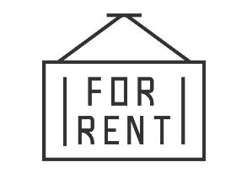
Property management best practices
Marketing and leasing
Conflict resolution
Maintenance and repairs
Accounting and taxes
Notes:
Introduce the areas of property management best practices covered in this lesson.

Slide 158
Marketing and leasing best practices
Conduct regional and neighborhood analyses
Set rental rates according to analyses
Create a marketing plan
Create a leasing plan
Develop leasing policies and procedures
Notes:
Review key marketing and leasing best practices.

Slide 159
What do you think?
Tenant/resident relations is a critical part of property management. One reason for this is that renewing a lease is more profitable than filling a vacancy.
How can property management create a positive experience for tenants/residents so that they renew their leases?
Notes:
Facilitate a discussion tenant/resident relations strategies.
Suggested answers:
Customer service approach
Well-functioning, responsive management and maintenance
Engagement events (e.g., open houses, wellness and sustainability fairs, BBQs)
Amenities and services
May also be a chance for ancillary income
Consistent policies and procedures

Slide 160
Conflict resolution best practices
Anticipate conflicts
Maintain respect and resolve
Try to understand different perspectives
Limit emotion and approach the situation critically
Notes:
Explain that conflict resolution is a critical skill of property managers. Conflicts arise between:
Management staff
Management and tenants/residents
Between tenants or residents
Management and clients
Staff and contractors
Review the conflict management best practices.
Anticipate conflicts – they are part of this business
Maintain respect and resolve in intervening and solving the conflict
Limit emotion; approach the situation critically and reasonably

Slide 161
Approaches to conflict resolution
Adversarial
Collaborative
Assertiveness
Compromising
Avoiding
Accommodating
Cooperativeness
Notes:
EXPLAIN the different approaches to conflict resolution.
ASK:
Is there an approach that is more right than others?
Is there a style you think should never be used?
When might you use each approach?
DIRECT students to pages 58-60 in the book for advantages, disadvantages and appropriate uses of each.
.

Slide 162
Conflict resolution steps
1. Acknowledge the conflict
2. Set expectations that conflict can be resolved
3. Clarify the facts of the case
4. Listen actively and reflectively
5. Negotiate a resolution using the appropriate style
Notes:
Review the steps to take in resolving a conflict.
Stress that arbitrators, lawyers, and other professionals may need to be consulted.
.

Slide 163
Maintenance and repairs best practices
Make the connection between maintenance and risk management
Develop a maintenance plan
Conduct inspections
Keep a maintenance log
Have a system for receiving and handling maintenance requests
Know when to use contractors
Maintain records (e.g., warranties)
Participate in capital planning
Notes:
Review key maintenance and repairs best practices.
Ask:
What is the connection between maintenance and risk management? Note that these fall in both legal and financial/investment risk management.
Prevent accidents (e.g., trip hazards)
Preserve asset
Maximize useful life of building equipment
Control operating costs
Engage tenants/residents (i.e. lease renewals)
Maintain cash flow
Explain that property management involvement with capital planning/investments will depend on the type/size of owner and other factors.

Slide 164
Preventive
Corrective
Deferred
Routine/custodial
Cosmetic
Efficiency/sustainability
Emergency
Types of maintenance
Notes:
Review the types of maintenance.
Ask:
What is an example of each type of maintenance?
Which type has the biggest impact on risk management and safety?
What are the benefits of preventive maintenance?
Bring out the following:
Preventive maintenance is a proactive approach that requires planning and prioritizing maintenance activities.
Benefits: adds years to life of equipment, sustains property in good condition, contributes to resident/tenant satisfaction, lowers costs/risk
Activities: tests, measurements, adjustments, parts replacement, lubricating motors, cleaning drains, daily/weekly/monthly schedules
Routine/Custodial: Day-to-day upkeep
Cosmetic: Enhances appearance but not operation/preservation
Efficiency/Sustainability: cost-effective operation/preservation
Corrective maintenance is after the fact, often reported by tenants
Emergency: unscheduled, must be performed immediately to prevent further property damage or to protect health and safety
Deferred maintenance is repairs or replacements that should have been completed but were purposely delayed

Slide 165
Accounting and taxes best practices
Prepare an annual operating budget for the property
Benchmark and track income and expenses
Receive and disburse funds in a timely manner
Have financial controls in place to prevent malfeasance
Know when owner approval is necessary for expenses
Report to owner regularly
Assist owner with tax obligations (but refer to tax attorney)
Notes:
Review key accounting and taxes best practices.

Slide 166
Key takeaways
Part 2
Notes:
Review key takeaways for Part 2.
Ask students to share their insights.
What did they learn?
What areas covered would they like to know more about?
Where will they seek additional information and education?

Slide 167
Part 2: Property Management
Case Study

Slide 168
Case study instructions
Take 10 minutes to read the scenario in the student workbook.
Answer the questions that follow the case study scenario.
Discuss your responses with the class.

Slide 169
Part 3 Louisiana Real Estate Commission Update
Notes:
Introduce Part 3.
Explain the following in your own words:
Learning objective:
By the end of this lesson, you will be able to:
Discuss updates on the Louisiana Real Estate Commission

Slide 170
lrec.gov
Notes:
Review key sections of the LREC website.
Point out navigation by role (I want to become Licensed, I am Licensed, I am a Consumer)

Slide 171
lrec.gov

Slide 172
lrec.gov

Slide 173
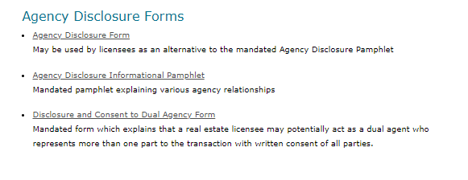
lrec.gov
Notes:
Point out the links to the agency disclosure forms on the page with other mandatory forms.

Slide 174
Notes:
Point out the sample property management agreement under additional real estate forms.

Slide 175
MyLREC Portal

Slide 176
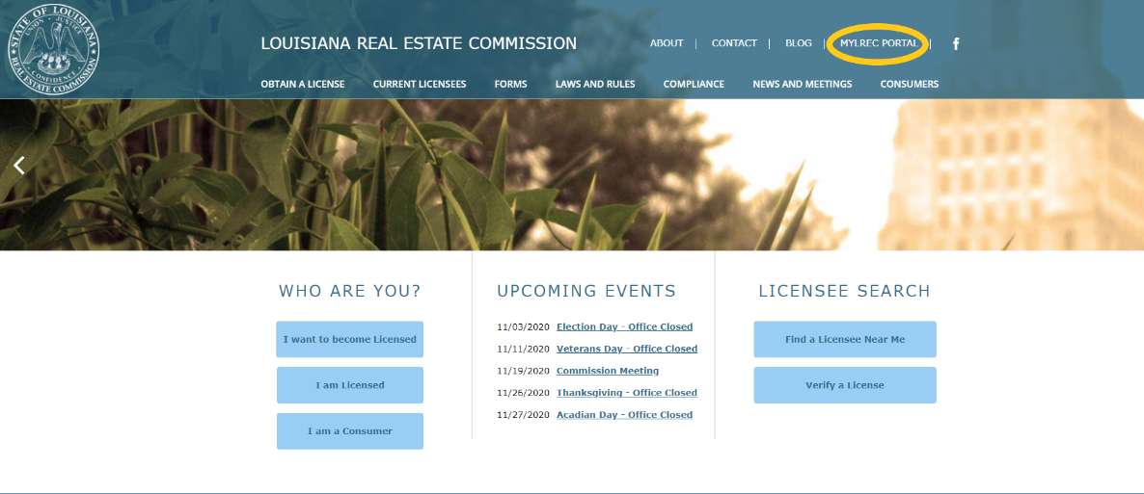
You can access the portal log in page by selecting MyLREC Portal from the header on any page of the LREC’s website.
How do I log on to the MyLREC Portal?
176

Slide 177
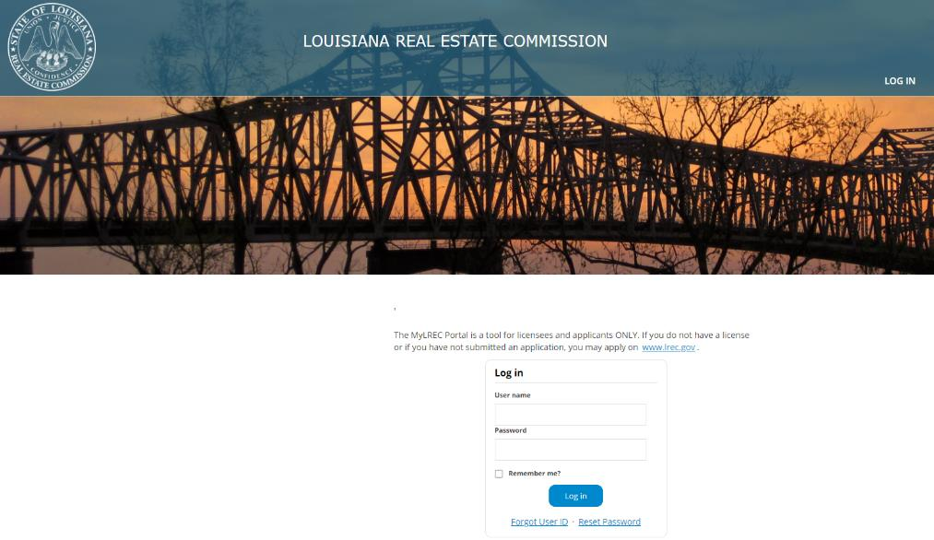
Your user name is automatically generated by the LREC. You can choose your own password and reset it if necessary. If you cannot remember your user name and password, you can answer questions to retrieve/reset them.
How do I log on to the MyLREC Portal?
177

Slide 178
Your user name is automatically generated by the LREC. You can choose your own password and reset it if necessary. If you cannot remember your user name and password, you can answer questions to retrieve/reset them.
How do I log on to the MyLREC Portal?
178

Slide 179
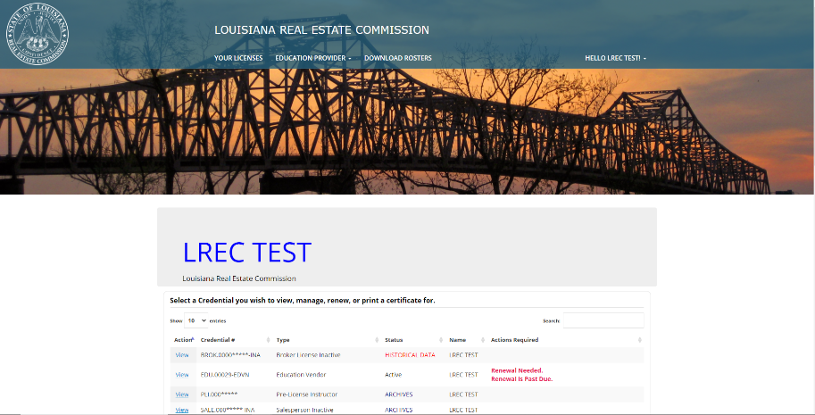
MyLREC Portal
After logging in, licensees who hold multiple licenses will be given a list of their licenses to choose which they would like to view and manage.
After logging in, licensees who hold only one license will bypass this page to view and manage their license.
179

Slide 180
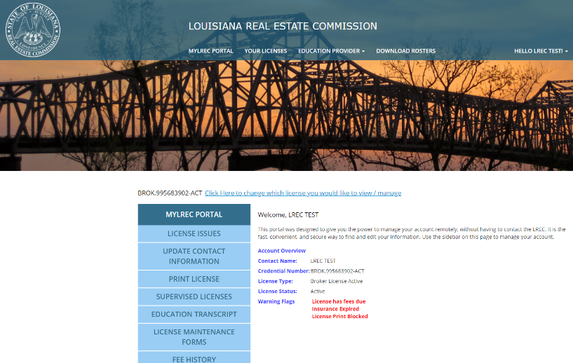
MyLREC Portal
Once you are inside the portal, you will see information about your selected license. This includes any warning flags, which indicate issues with your license that you may need to address to keep your license in good standing.
180

Slide 181
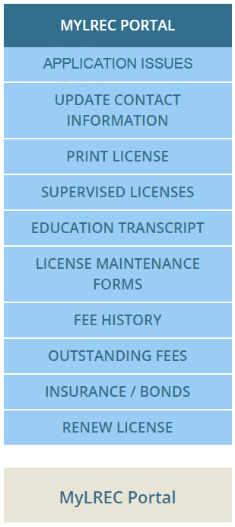
MyLREC Portal
The MyLREC Portal gives licensees easy access to manage their license using an easy to navigate sidebar with selections tailored to their license type.
The tailoring of the sidebar view allows for easier navigation and eliminates confusion about what a licensee needs to maintain good standing with the Commission.
For example, the options of “Outstanding Fees” or “Regulatory Compliance Cases” only show up on the sidebars of licensees who have outstanding fees or who have a past or present case status.
181

Slide 182
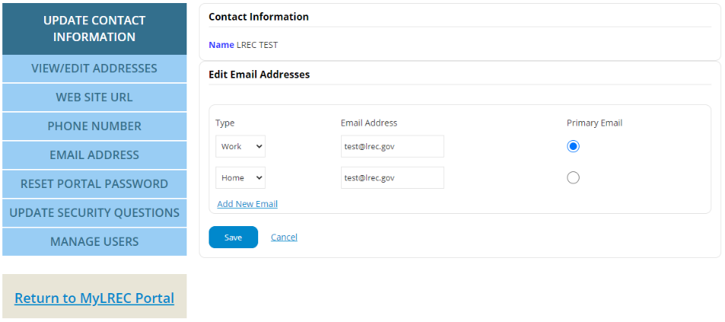
MyLREC Portal
Licensees can easily and immediately update their contact information, including email address, phone number, mailing address, etc. inside of their portal. This is a very useful tool as the LREC Rules and Regulations require that licensees notify the Commission within ten days of an address change. In the past, this meant printing and mailing in a paper form. The portal allows for a quick, paperless updating option.
This also allows for licensees to ensure that they receive all important updates from the Commission, which will be sent to the email address on file. Licensees can choose their primary email address within the portal to make sure that they receive all notices sent by the Commission.
182

Slide 183
MyLREC Portal
The MyLREC Portal gives licensees easy access to view/print their license. This has not been an available function to non-broker licensees in the past.
Those licensees who are in good standing will be able to access their license by choosing “Print License” from the sidebar. Licensees with issues that prevent printing will be shown a list of the issues they need to address before their license will be made available for printing.
183

Slide 184
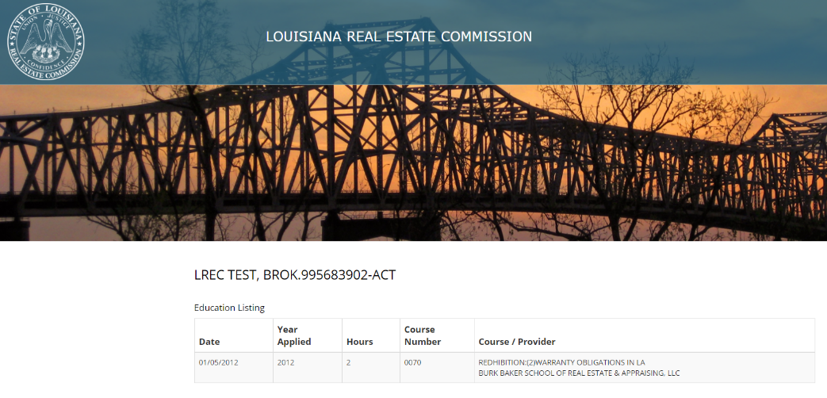
MyLREC Portal
The MyLREC Portal gives licensees easy access to view their education transcript in order to ensure compliance with LREC requirements.
184

Slide 185
MyLREC Portal
Licensees can find a history of payments made to the LREC within their portal under “Fee History.” This is useful for individuals wishing to check their renewal status, E&O insurance coverage, etc. Fee history can be shown for the past 5 years, 10 years, or all time based upon the licensee’s input.
185

Slide 186
MyLREC Portal
Licensees can view the status of their Errors & Omissions insurance coverage to ensure that they are properly insured while practicing.
186

Slide 187
MyLREC Portal
Licensees can renew their license(s) using the MyLREC Portal. Licensees will be given the option to renew online or print a paper renewal. The online renewal process is simple and secure, allowing a licensee to respond to required questions and pay their renewal fee via credit card or ACH payment quickly and without any paperwork and mail delays.
187

Slide 188
MyLREC Portal – Brokers
Brokers can now view a list of all of the licensees under their supervision in their portal. This listing includes the status of each licensee under the broker’s supervision, allowing the broker to monitor the status of the licensee’s education, renewal, etc.
188

Slide 189
MyLREC Portal
Additional features are planned for the MyLREC Portal. Licensees should log in regularly to make sure that they do not miss out on upgrades!
189

Slide 190
Resources and references
Best Practices: Real Estate Management Service
HRS402 Leading a Winning Property Management Team
Louisiana Real Estate Commission = lrec.gov
MNT402 Managing Maintenance Operations and Property Risk
RES201 Managing Residential Properties

